Slide 1
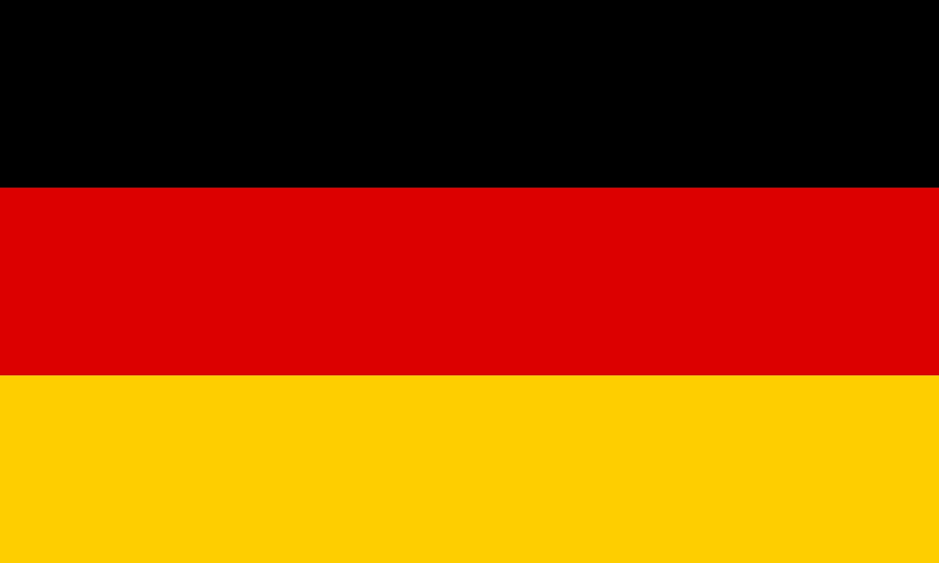
GERMAN CULTURE – WHAT DID WE LEARN

Slide 2
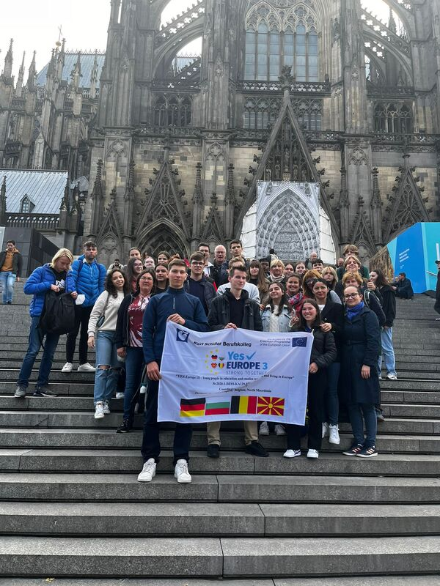
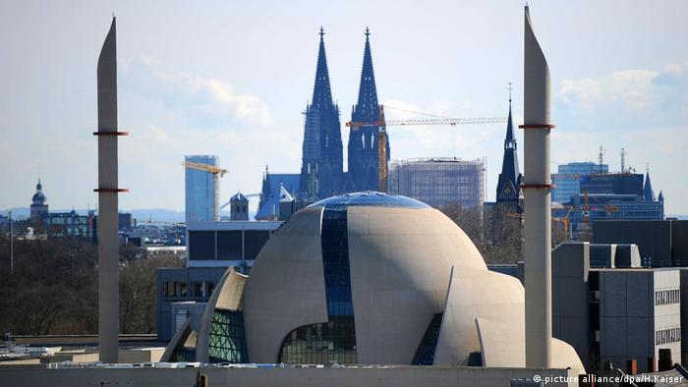
Rich history
Is known for its long and rich history
Built a lot of church
Mosque

Slide 3
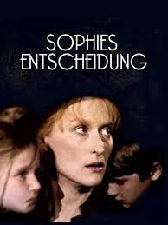
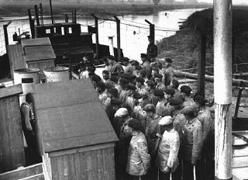
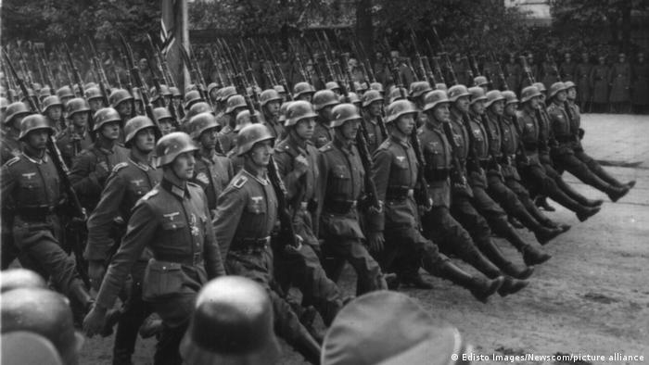
world War
The leader of the Central Powers, which included Austria-Hungary
Innocent jewish people were killed in concentration camps

Slide 4
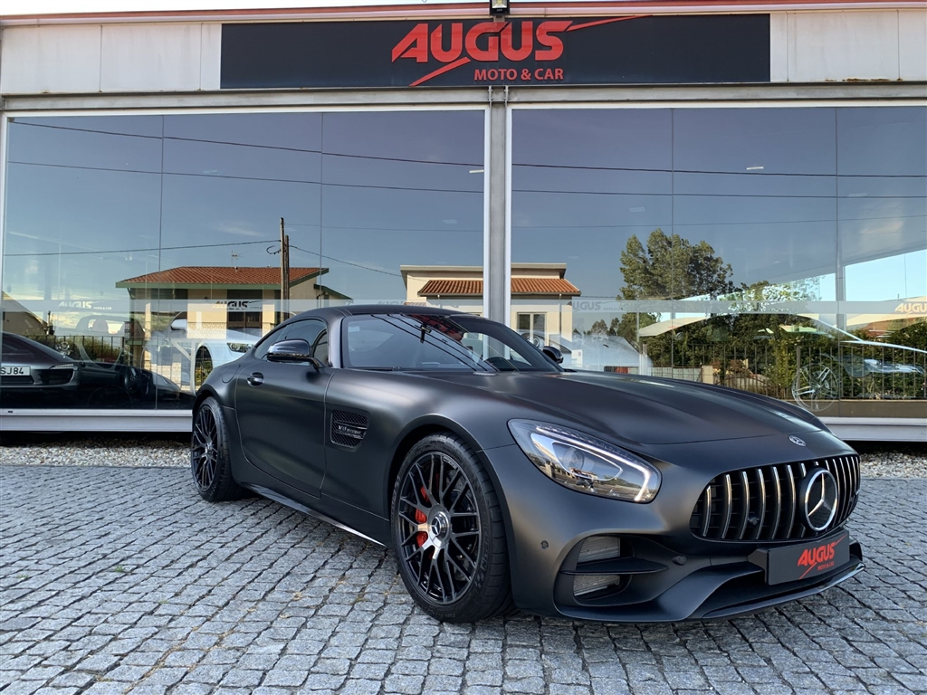
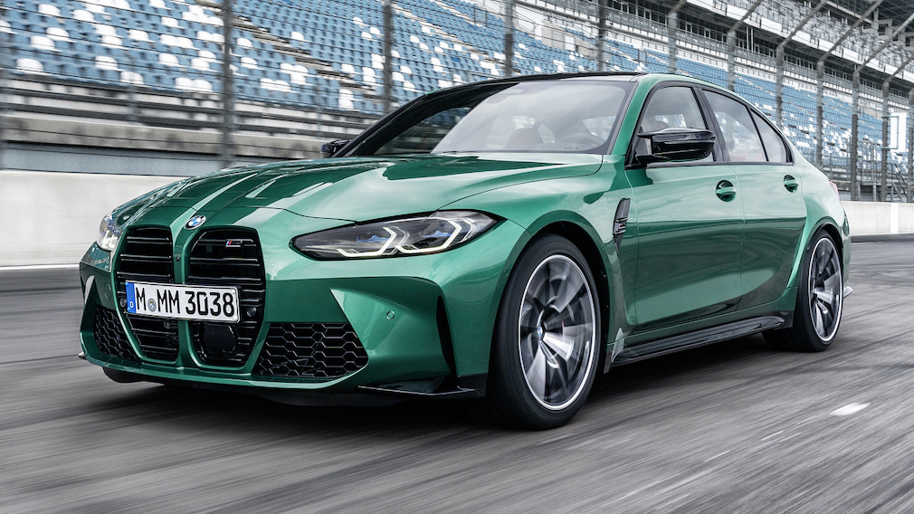
CARS
Symbolize freedom lifestyle and power
Bmw
mercedes

Slide 5
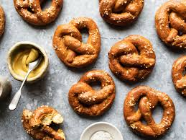
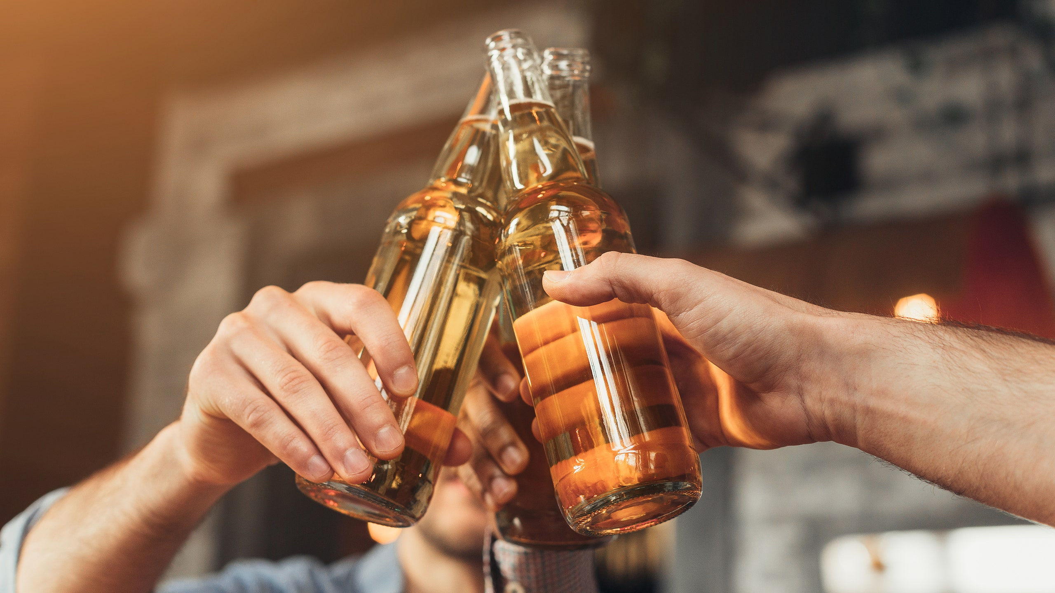
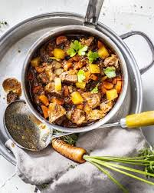
Food and drinks
Fried potatoes
Curry wurst
Pretzel
Bier
Stew

Slide 6
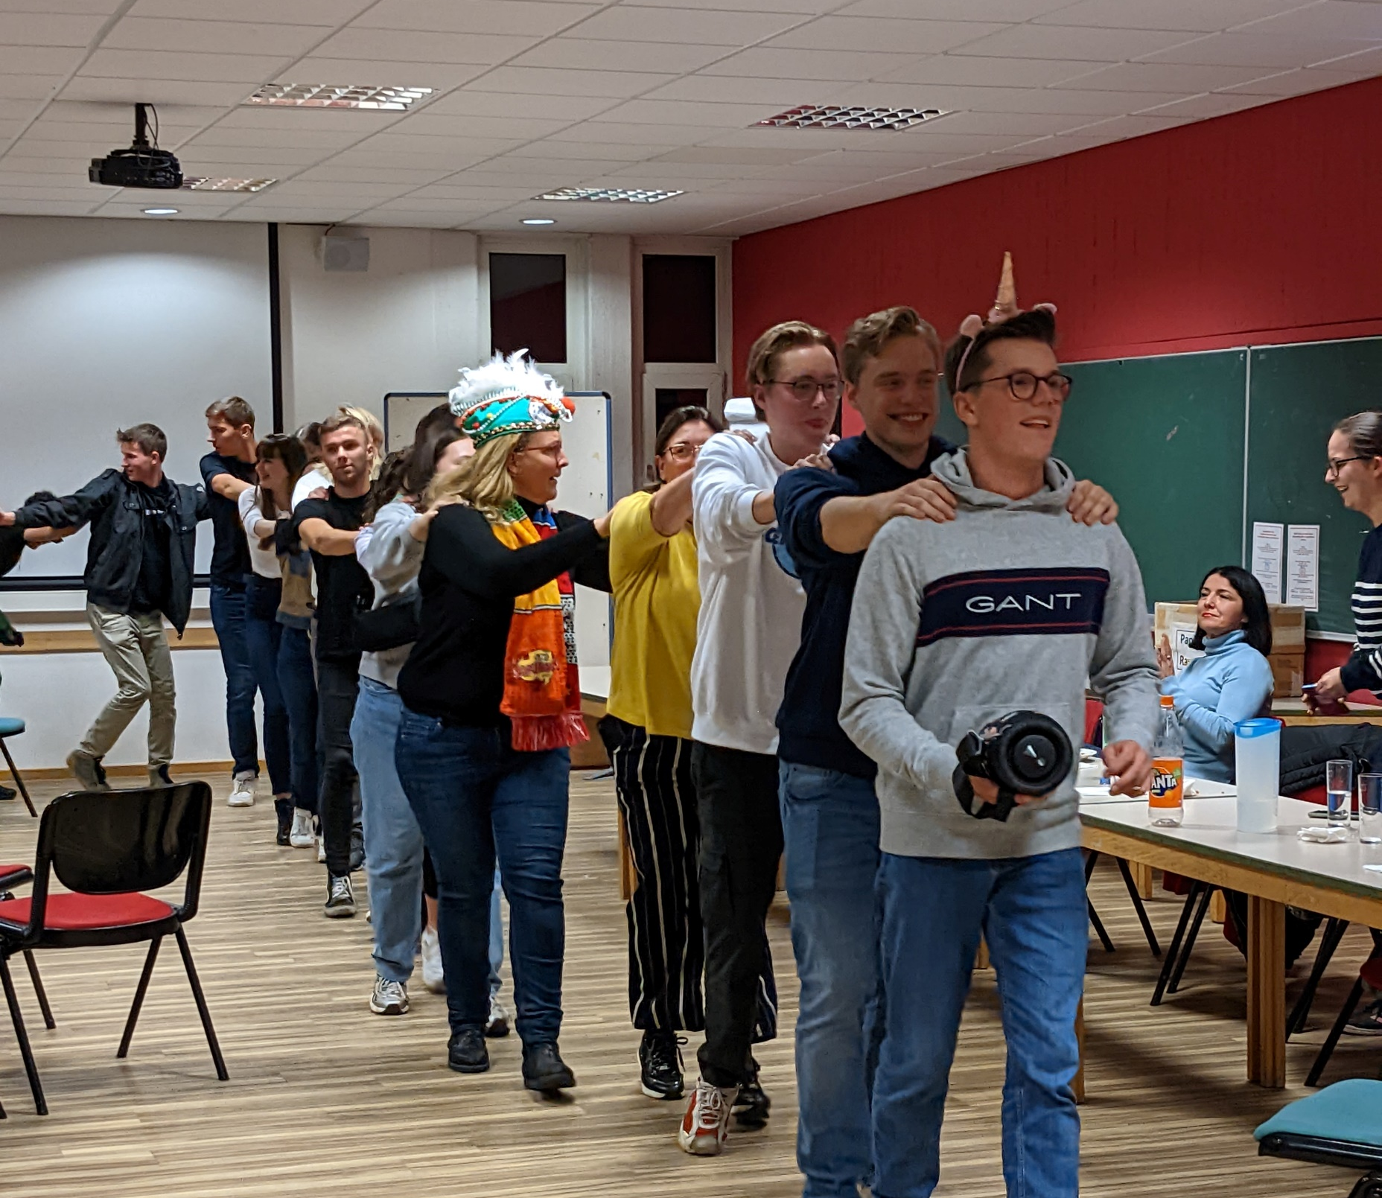
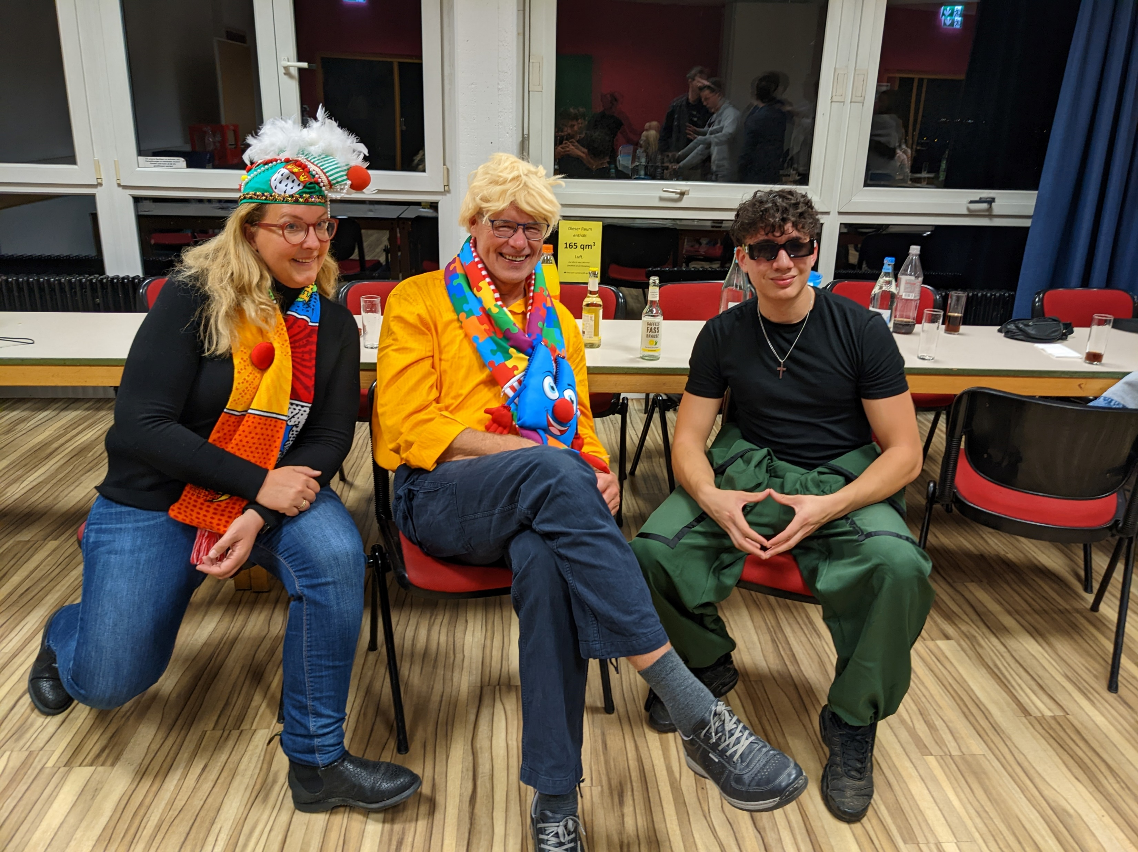
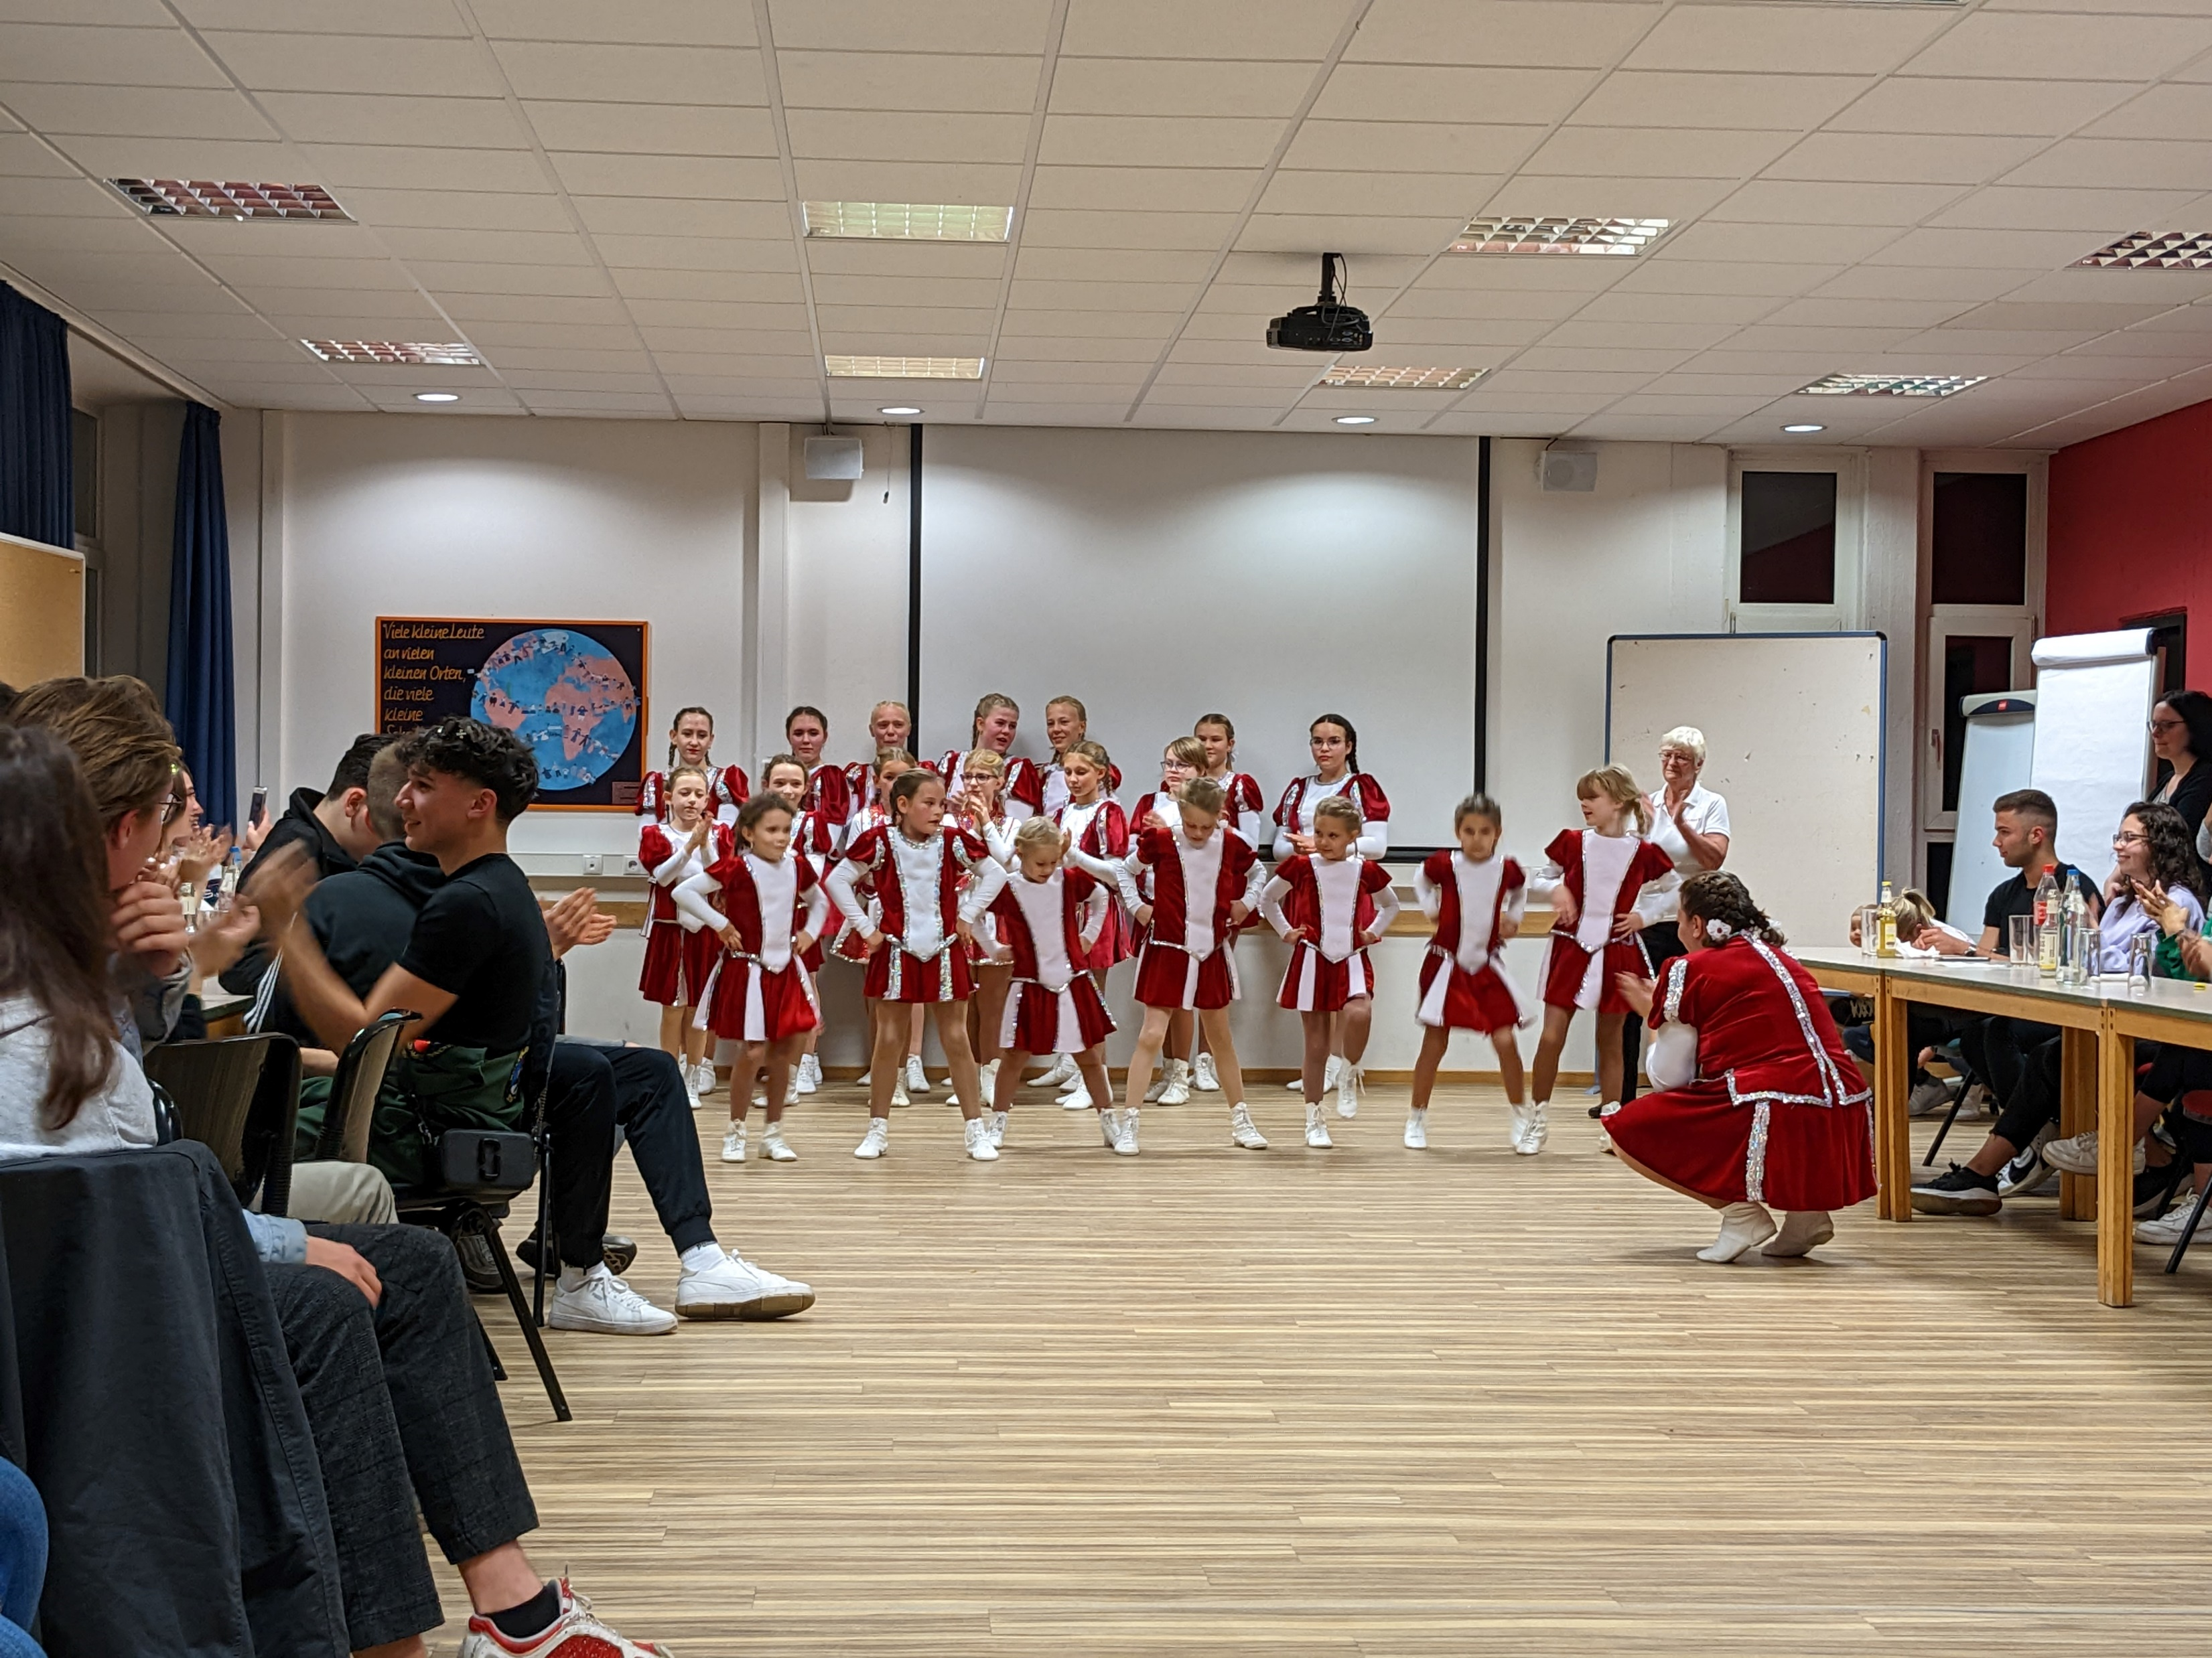
Carnival
Drink a lot of bier
Cheap
Meeting new people
Brings people together

Slide 7
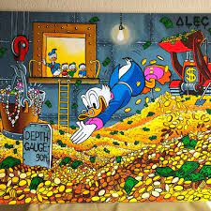
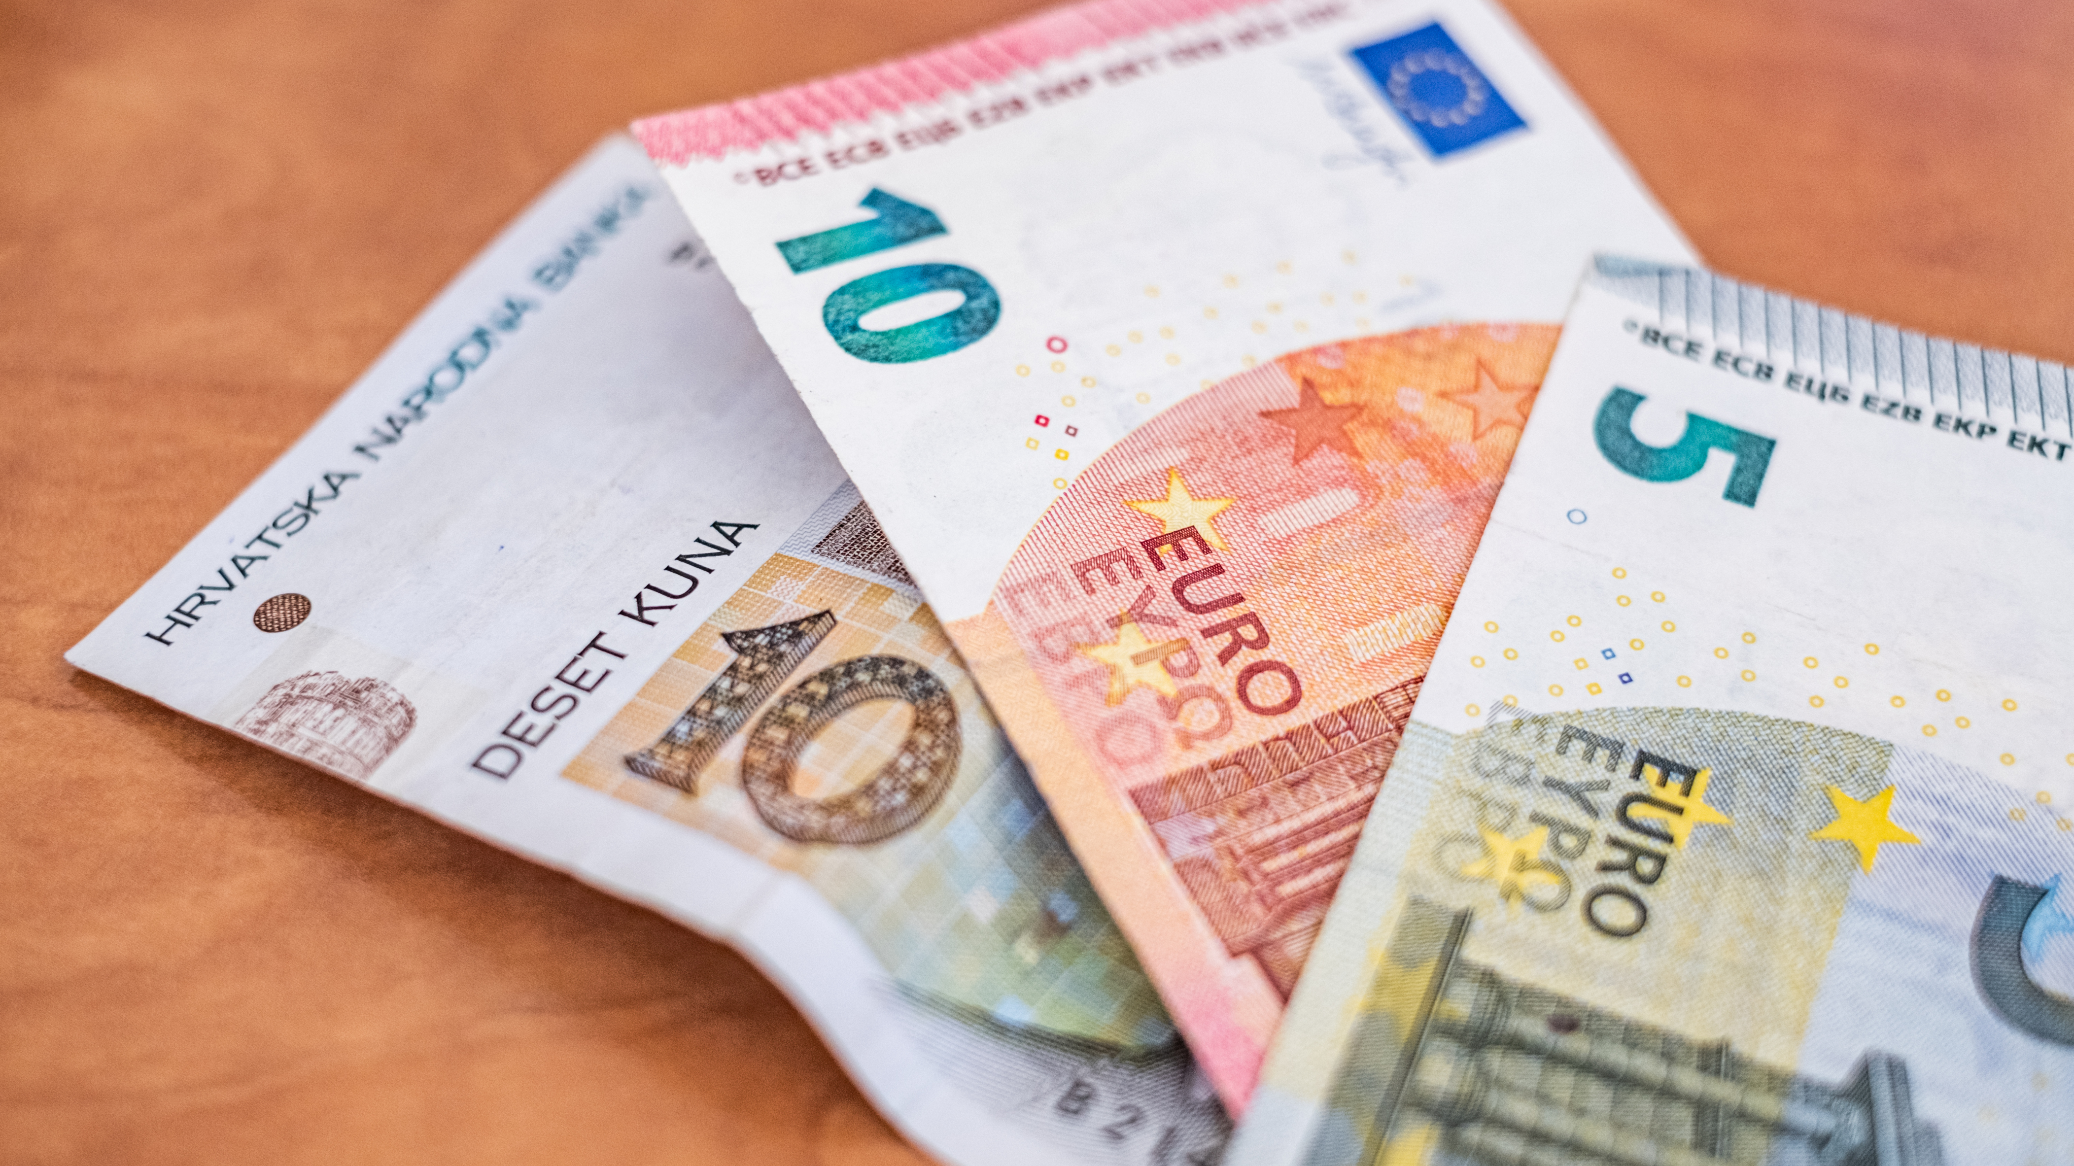
Typical characteristics
Hate being late Save money Stingy

Slide 8
Thank You

