Slide 1
ACCOMODATION HUNT
- Workshop-

Slide 2
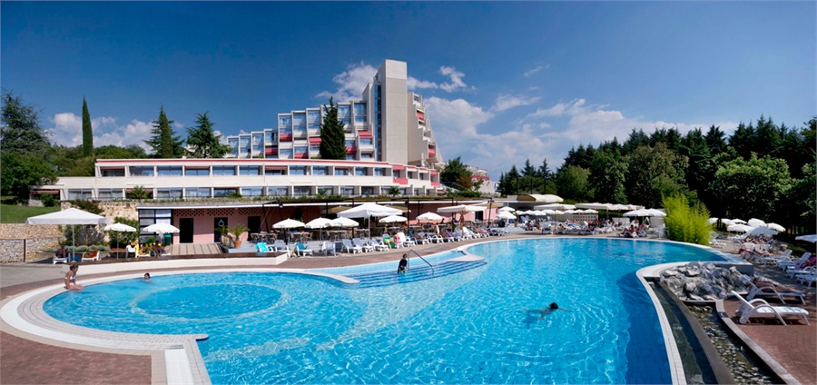
TASK 1
You have found a job in one of the two biggest hotel companies in our region: VALAMAR RIVIERA or PLAVA LAGUNA.
Choose one of the companies and find its headquarters on the city map.

Slide 3
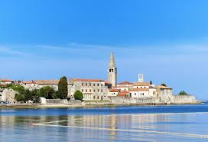
TASK 2
Search online for an accomodation for a longer period of time in Poreč.
Find a tourist or a real estate agency to help you find accomodation.
BE CAREFUL! You have a limited budget of 400 € per month!
http://www.myporec.com/hr

Slide 4
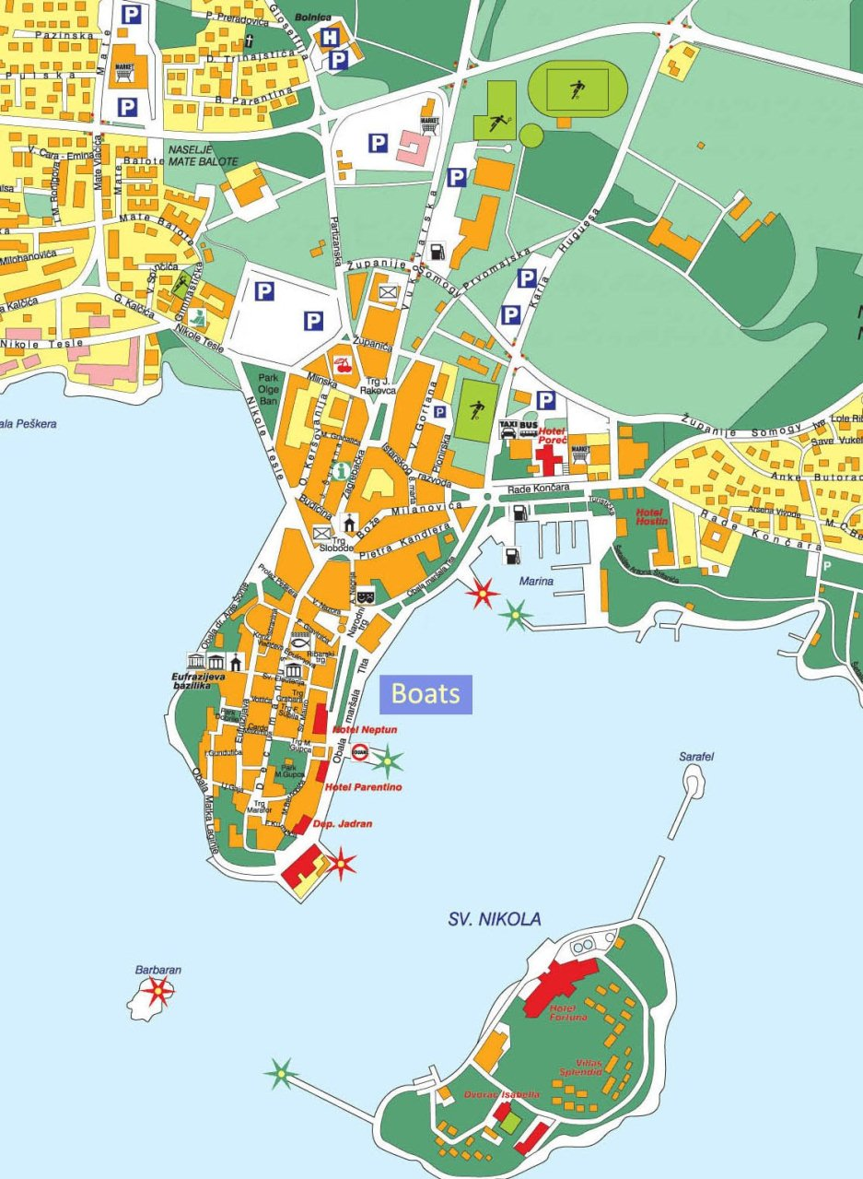
TASK 3
On the map, find the easiest and the shortest way to get to work.
Calculate the time it takes to get there, and think about the means of transportation you would use each day to get to work.

