Slide 1
HOW TO FIND A JOB IN flanders
Working in Flanders

Slide 2
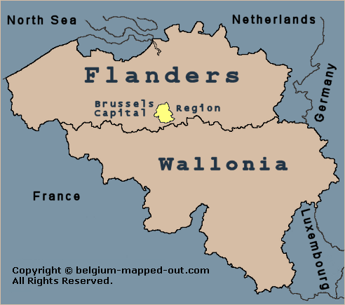
Flanders?
3 Regions in Belgium:
Flanders
Wallonia
Brussels
public employment service of Flanders= VDAB
EU citizen: allowed to work without work permit
Notes:
There are three regions in Belgium: the Flemish Region, the Brussels-Capital Region and the Walloon Region have powers relating to the economy, employment, agriculture, water policy, housing, public works, energy, transport (except Belgian Railways), the environment, town and country planning, nature conservation, credit, foreign trade, supervision of the provinces, communes and intercommunal utility companies.
They also have powers relating to scientific research and international relations in those fields.
It’s important for you to know that each region in Belgium has its own responsibilities and administrative regulations.
This concerns your jobsearch, diploma recognition, education, integration path and other. Labour market support is regional:
VDAB: for Flanders, official language: Dutch.
If you an EU citizen, you do not need a work permit to work in Belgium.

Slide 3
Services vdab
Vacancies for international profiles
1
Create your CV
2
Raise your visibility as a jobseeker
3
Match employers & employees
4
Courses
5
Notes:
On vdab.be you will find thousands of job offers.
The Europass CV is a great tool to promote your skills, your qualifications and your experience to potential Flemish employers. It offers a easy to (re)use standardised format that is recognised throughout Europe and Flanders.
You can publish your CV on vdab.be for employers to read it and contact you.
A consultant can offer you guidance and personal assistance in your search for a job.
The VDAB offers many training courses, for example, to learn Dutch or a certain profession.

Slide 4
In a nutshell
Register with VDAB!
Training
Vacancies
General support
Notes:
Finding a job: you can search their job database and they will forward vacancies to you
They offer free vocational courses in order to improve your job prospects

Slide 5
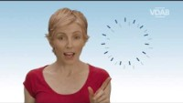
https://youtu.be/1jaOe8UkMUA

Slide 6
TEST

Slide 7
What kind of job would suit me best?
PERSONALITY
CAREER
First step
Understanding of who you are
Second step
Finding the right career
Notes:
The first step in finding a job is knowing who you are and what you want or what you are good at. What are your interests and what is important to you? The following test gives you an understanding of your personality and the career areas that would be best suited to you. Take the quiz and share your findings with your fellow sutdents.

Slide 8
Personality & career quiz
Take the quiz & find out about your personality type.
Choose a career based on your results.
Group together with those that have the same personality type.
Share & discuss your findings in group.
Create a mind map by organizing your ideas and results.
Notes:
what job did you choose? Why? Do you agree with the advice given, suggestions that were made?

