Slide 1
How to find a job In turkey

Slide 2
ESSENTIALS
Your job search will depend on where you want to work.
You can find part-time tourism jobs posted online (or on cork boards!).
If you want to teach in Turkey, you might have to visit schools in person to find information on openings.

Slide 3
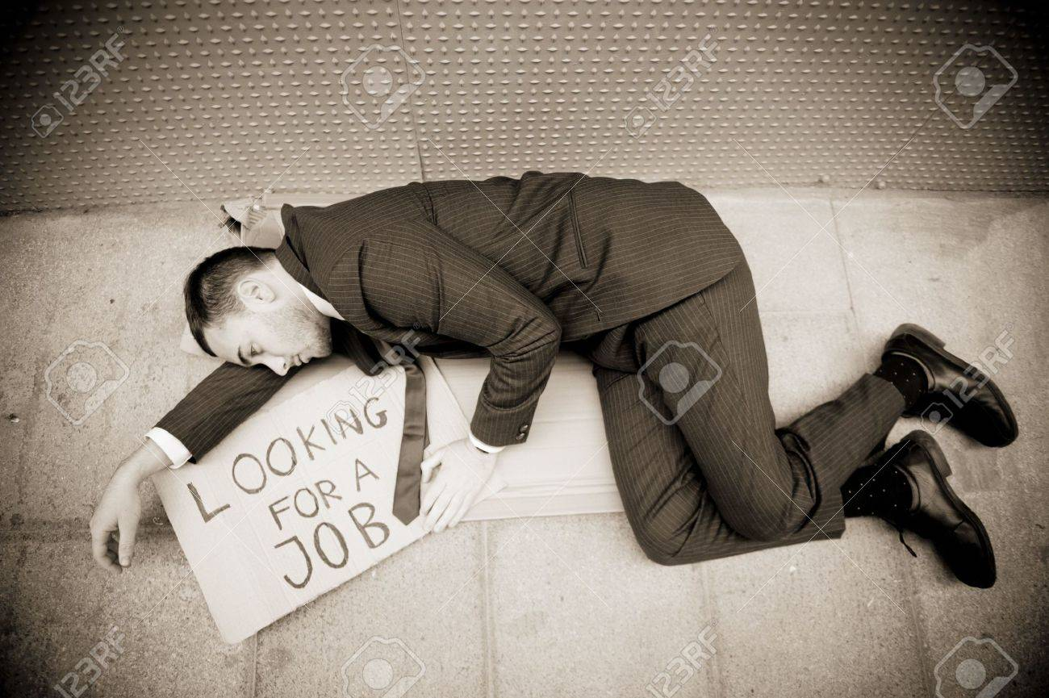
It is best to find a job before you arrive in Turkey, not only for your peace of mind but so that you can obtain the proper visa and permits.
If you feel your qualifications might be lacking, try visiting a few dershanes (private schools).
Make sure to have your passport, a copy of your degree, a teaching certificate (when applicable), a curriculum or resume, and a passport-size photograph.

Slide 4
Dershanes will often hire teachers without formal teaching certifications.
Finally, check with smaller, private language schools. There are hundreds of these throughout Turkey, and while some require extremely formal qualifications, others will be content with an outgoing personality and a college degree.
As with part-time work, be aware that many (particularly smaller) language schools may not sponsor a work visa. If this is the case, you will have to leave Turkey every three months and then re-enter in order to remain in the country legally.
Make sure you ask whether you will get a work permit before you accept a job.
If you don´t have a job before you arrive in Turkey, get ready for an adventure.

Slide 5
Part-time work
Part-time work, especially in tourism, is readily available throughout Turkey.
To maximize your chances of finding work, aim to arrive in March or April.
This gives you time to find something before the tourist season starts.

Slide 6
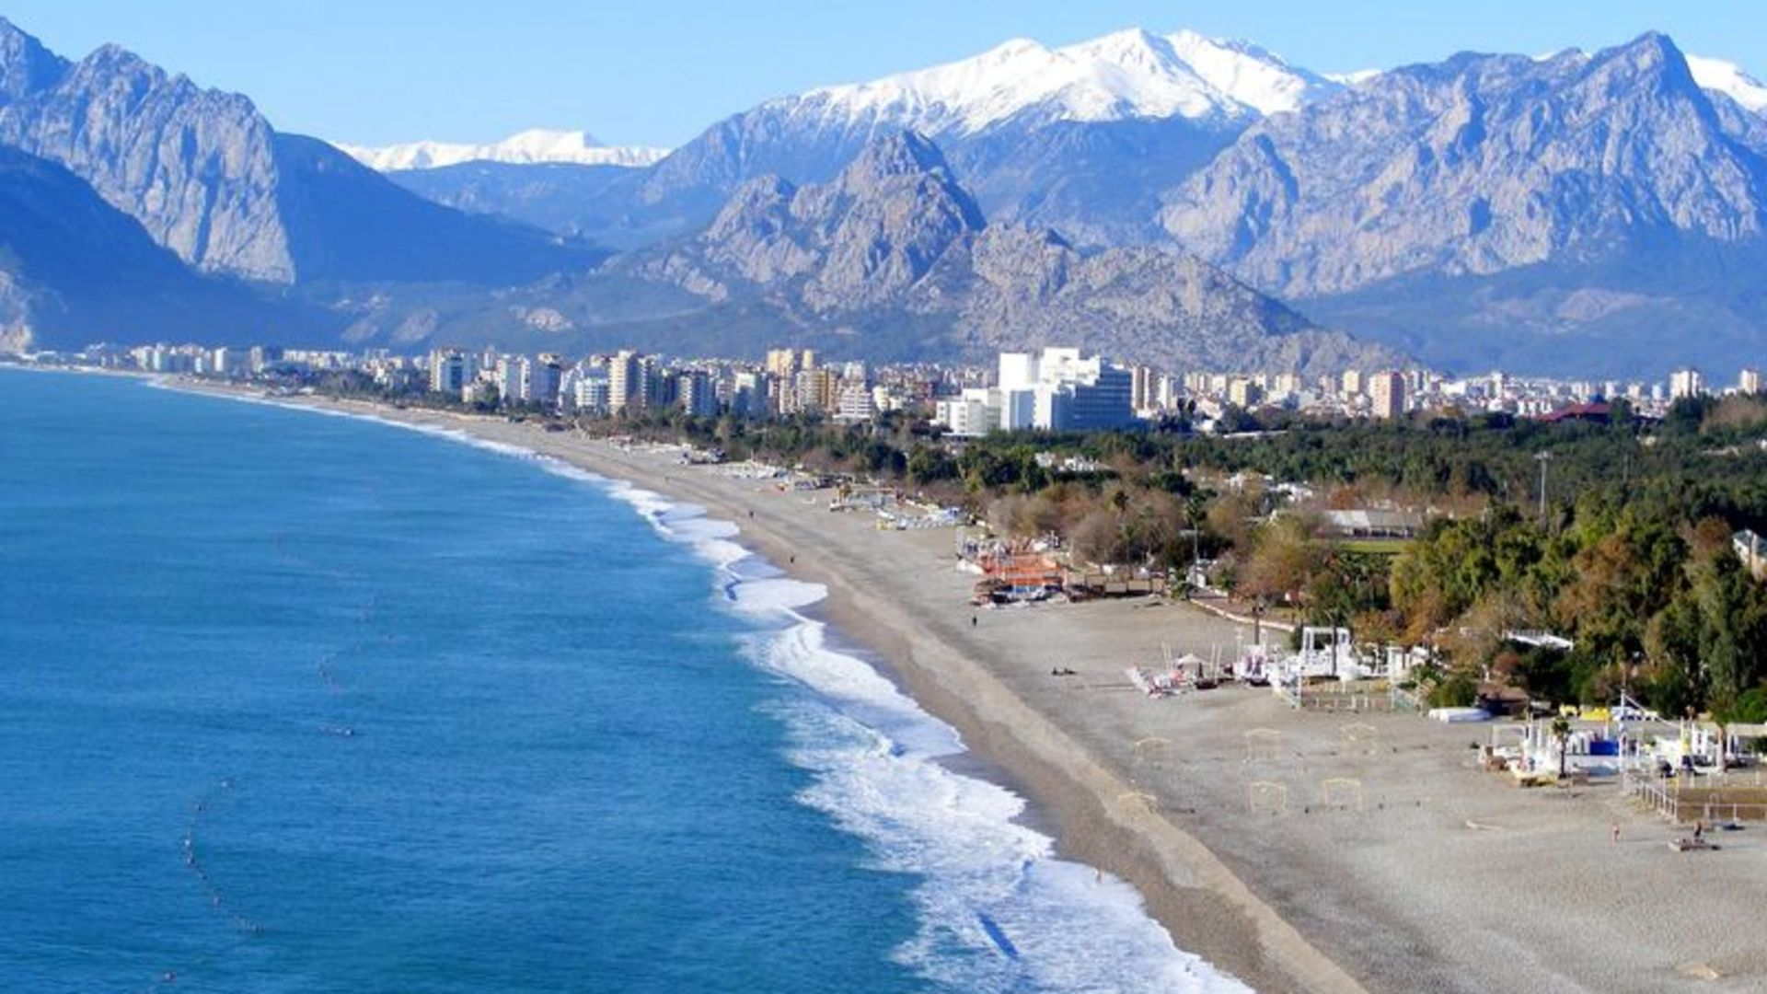
You will not be well-paid for this kind of work, and as a result, it´s best for young people who aren´t looking to save. If you´re working in a bar, for Instance, you may be paid enough for your rent and earn the rest in alcohol!

Slide 7
CV, cover letter and Interview
Write a Turkish CV in the third person singular. Tape it in chronological order on one, maximum two pages in a direct factual style, which only gives the facts and figures.
The aim of your Turkish CV should be to persuade recruiters to invite you for a job interview. Therefore, keep it brief yet give the reader a hook, a reason to call you for that interview. Your covering letter should note more than 3-4 paragraphs. It is increasingly more common in Istanbul to apply for a job through the Internet.

Slide 8
However, you should be aware that an electronic CV does not look the same as a standard one. CVs are often scanned by employers, so make your CV scannable by avoiding for example lines or italic fonts etc. It's always best to back it up with an old fashioned snail mail pack.
During the interview, you will have to describe and explain your experience noted in your CV. Avoid talking about the salary at the first interviews and wait for the company to offer you the position before you raise the subject.
There are different visa requirements for people of different countries. As Turkey is still not part of the EU, entry regulations are set according to agreements between the various countries and Turkey. There are five kinds of visa situations you can be faced with when entering Turkey.

Slide 9
Citizens of some countries including Netherlands, Malaysia, Denmark, Chile etc can stay up to three months without a visa in Turkey
Citizens of some countries including Romania, Macedonia, Croatia etc can stay up to two months without a visa in Turkey.
Citizens of Bolivia, Kazakhstan, Maldives etc can stay up to 1 month without a visa in Turkey
Citizens of some countries need a visa to enter Turkey but this can be easily obtained at the airport upon arrival in Turkey. This applies for citizens of USA, Austria, Brazil, Canada, UK etc.
All other citizens need to apply for a visa at the Turkish embassy or consulate nearest them.
For a complete listing of which countries are eligible for which visa situation, please click here. http://www.enjoyturkey.com/info/usefull_info/Passport_Visa_Customs.htm

Slide 10
Visa Types
Sticker Visa
This visa is easily available at the airport for citizens of certain countries including USA, Austria, UK, Brazil etc who require a visa to enter Turkey. Depending on the country, the visa allows you to stay for between 15 days and 3 months.
Work Visa
As a general rule, a letter of employment from the Turkish employer is required. This letter needs to be presented at the Turkish Consulate or Embassy in the applicant's native country. Apply in advance as it usually takes about two months to be processed. For more information, click here. http://konsolosluk.gov.tr/fr/en/Vize.aspx

Slide 11
Transit Visa
By Air: If you are a visa national, you will not need a visa as long as you are passing through the country immediately. Please note that you cannot leave the airport under these circumstances and you must hold a ticket to a destination out of Turkey.
By Sea or Land: If you intend to travel by sea or land via Turkey, you will need a visa. The application process is the same as that of applying for a tourist visa.
Visas for Filming and Academic Research
For any documentation, filming, archaeological exactions etc within Turkey, you will need to obtain prior permission from Turkish authorities.

Slide 12
The work permit for foreign nationals
The first step to applying for a work permit in Turkey is to get a letter of employment from the potential employer in Turkey.
The application should be made from the country of origin, i.e. via the nearest Turkish Consulate or Embassy unless they are the holder of a residence permit for Turkey which is valid for at least 6 months.
Applications for extension of a given work permit can be made in Turkey if accompanied by a valid residence permit.

Slide 13
Bear in mind that the work visa procedure is double application in nature. This means that while the employee puts a claim for work visa in his native country, the employer makes a simultaneous application in Turkey by submitting a file to the Ministry of Labour and Social Security, Department for Work Permits for Foreigners.
There should not be more than 3 working days between the employee's and the employer's applications. When applying, make sure your employer is aware of this as many are not familiar with these formalities.
As a result, it is wise to make your application only after ensuring that your employers are ready as well to submit an application so that both applications can be combined and processed.
The documents required from the employers are specified in the web page of the Ministry of Labour and Social Security: www.yabancicalismaizni.gov.tr . The web page is currently available only in Turkish.

Slide 14
It usually takes 2 months for the application to be processed. Upon the receipt of the approval of the Ministry for a work permit application, the applicant is immediately notified of the result and is required to come to the Consulate again with his passport to get the work visa that is the stamping of the work permit in his passport.
Applicants who fail to ask for work visa within maximum 3 months after notification have to renew their applications.
Issuing work visa takes maximum 3 working days and if the applicant cannot collect it in person, he can give a postal order to the Consulate so that the passport can be posted to him. Foreigners who enter Turkey on the basis of work visa are expected to get a residence permit within 30 day's of their entry.
For more information, please log onto http://konsolosluk.gov.tr/fr/en/Vize.aspx

Slide 15
THANKS FOR YOUR ATTENTION

