Slide 1
BELGIUM-LEUVEN GO! atheneum Leuven
Belgium
School system in Belgium
Our school, Campus Redingenhof
Information about Leuven
Highlights from Leuven

Slide 2
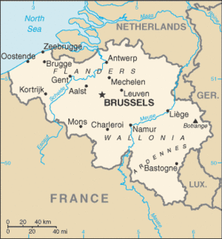
BELGIUM
Small country
Western Europe
11 million residents
Capital city = Brussels
4 neighbours
1. The Netherlands
2. Germany
3. Luxemburg
4. France
Bordered by the North Sea

Slide 3
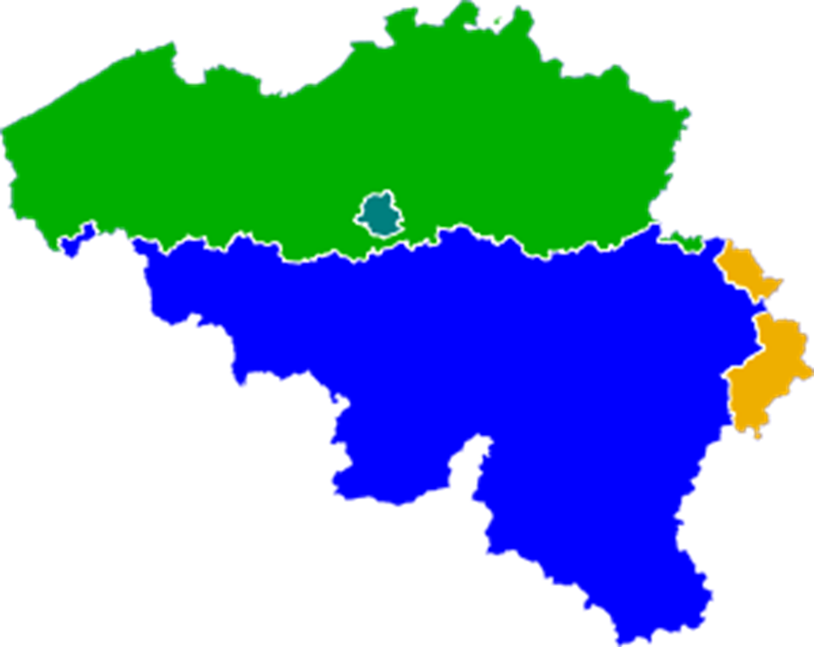
BELGIUM
Flanders
DUTCH-SPEAKING
FRENCH-SPEAKING
GERMAN-SPEAKING
BRUSSELS: DUTCH + FRENCH
Wallonia

Slide 4
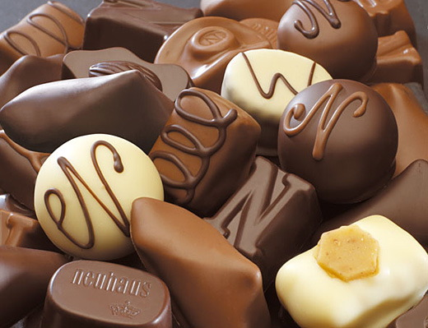
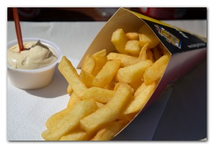
BELGIUM
3 typical Belgian things
Chocolate
Beer
French Fries

Slide 5
SCHOOL SYSTEM IN BELGIUM
Nursery school – as of 3 years old
Primary school – 6 to 12 years old
Secondary school – 12 – 18 years old
College or university - 18 to ? years old

Slide 6
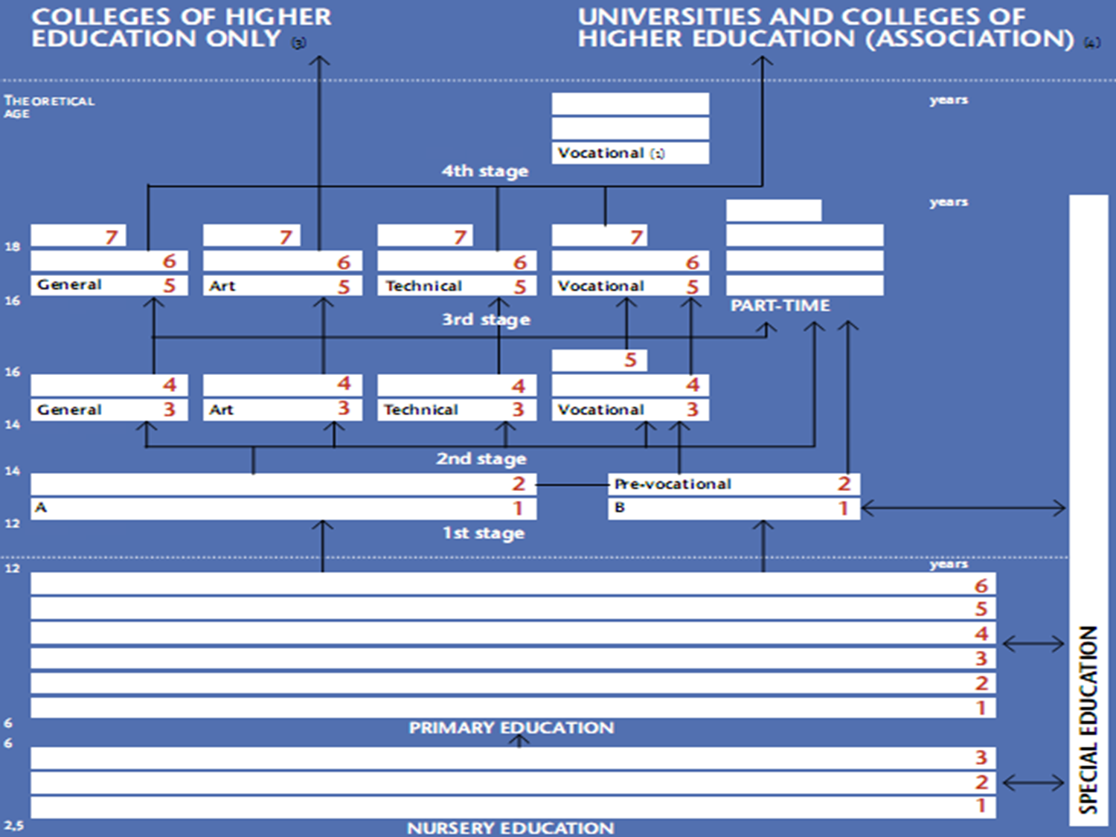

Slide 7
OUR SCHOOL, CAMPUS REDINGENHOF
ASO (general)
Professional Athletes
Sports & sciences
TSO (technical)
Social sciences
Informatics
Sports
Tourism
Commerce
BSO (vocational)
Woodwork
Car mechanics
Hair dressing
Office administration
Publicity

Slide 8
Our school:

Slide 9
Playground: a place to meet

Slide 10
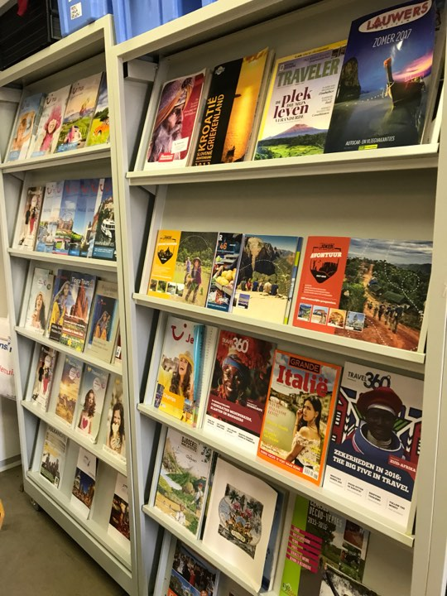
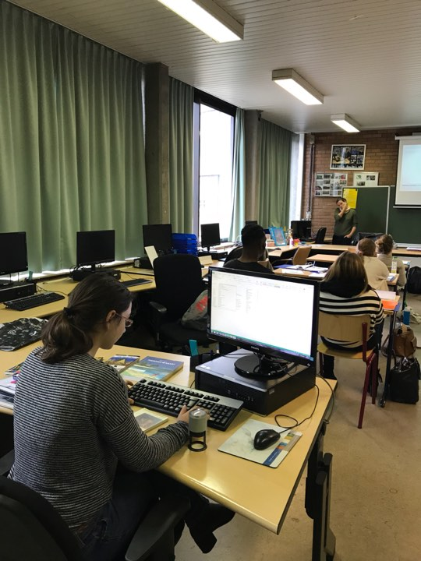
TSO/ Technical - Tourism class

Slide 11
ASO/TSO: Sport

Slide 12
BSO: Hairdressing
This is where the students learn how to cut and style hair.
Teachers can book an appointment.

Slide 13
BSO: Publicity

Slide 14
BSO: Automechanics and Woodworks

Slide 15
School restaurant:

Slide 16
LEUVEN
Located east of Brussels
100 000 inhabitants
8th largest city of Belgium

Slide 17
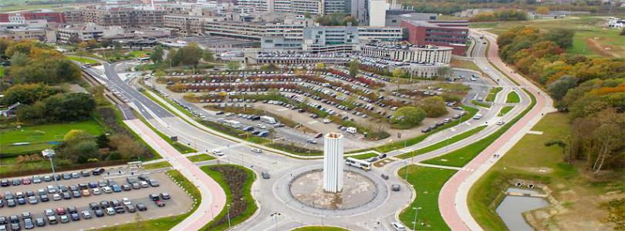
Important information about LEUVEN
Catholic University Leuven
Student city
UZ Leuven

Slide 18
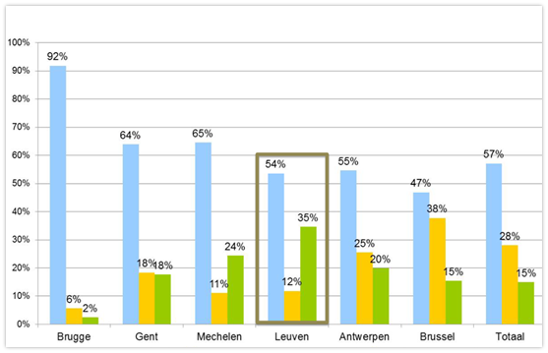
Type of tourism in LEUVEN
855 000 tourists a year
2 kinds of tourists
Business
= more important
Leisure
Blue: Leisure
Yellow: Business
Green: Business

Slide 19
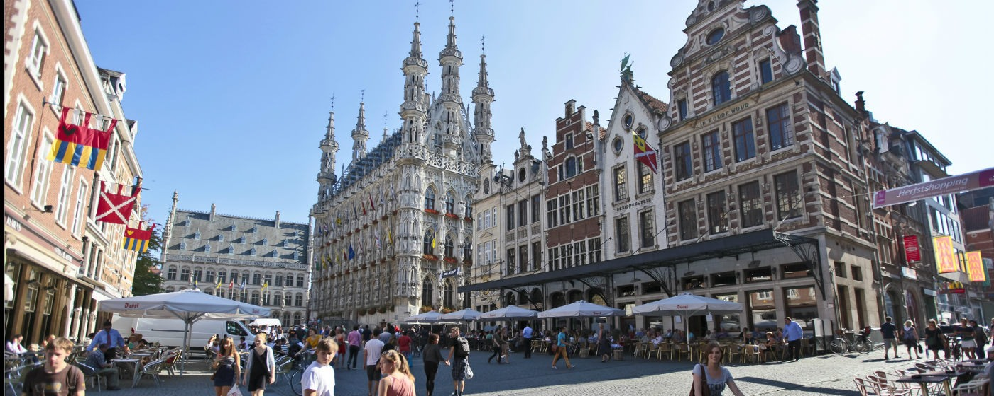
Highlights of Leuven
Brewery Stella Artois
Top 9 things to see
Oude Markt
Saint Peter’s Church
Town Hall
M-museum Leuven
Botanical Garden
University library & tower
Great Beguinage
Park Abbey

Slide 20
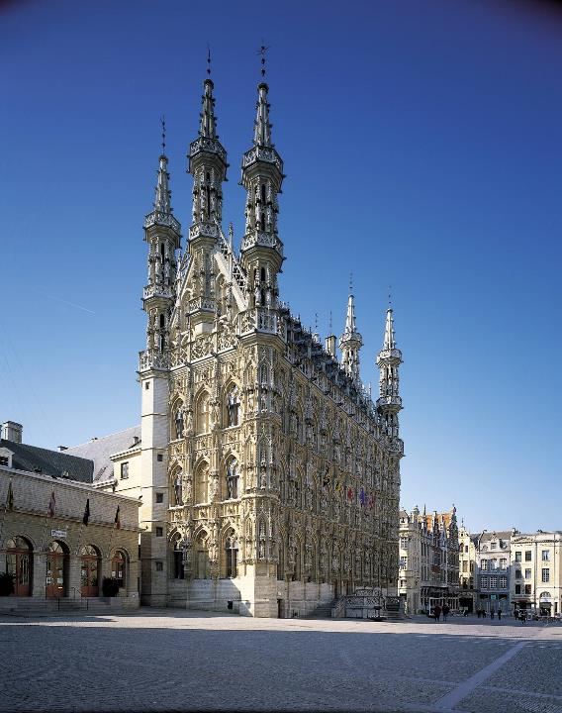
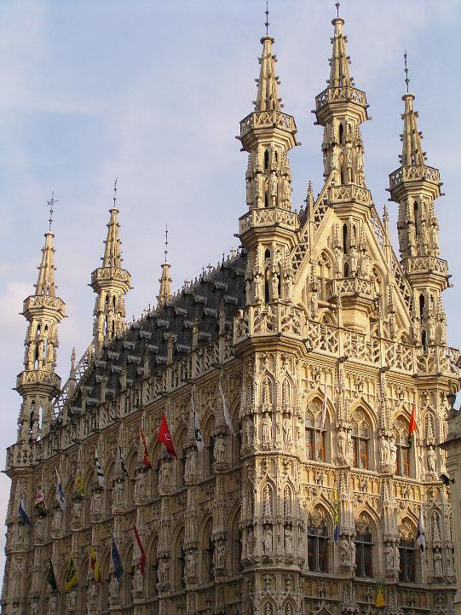
Town Hall
Gothic
3 architects
30 year
236 statues
Ceremonial function

Slide 21
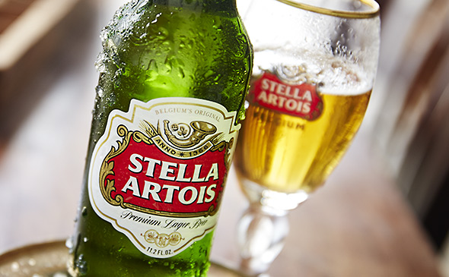
Stella Artois (The Artois Brewery)
Belgian Pilsner
1926
AB InBev
= biggest brewery in the world
Visit

Slide 22
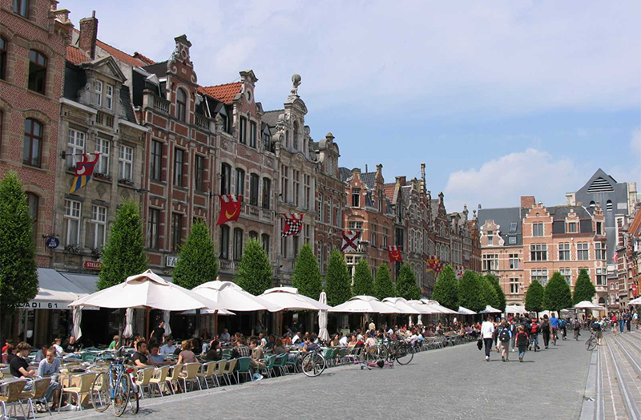
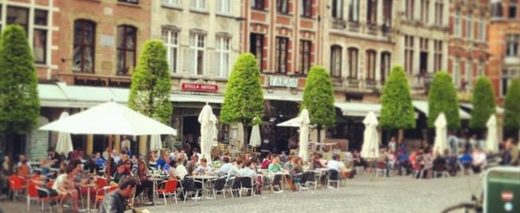
Oude Markt
Longest bar in Europe
Catering establishments
Meeting place
Popular in warm weather

Slide 23
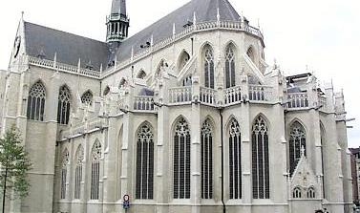
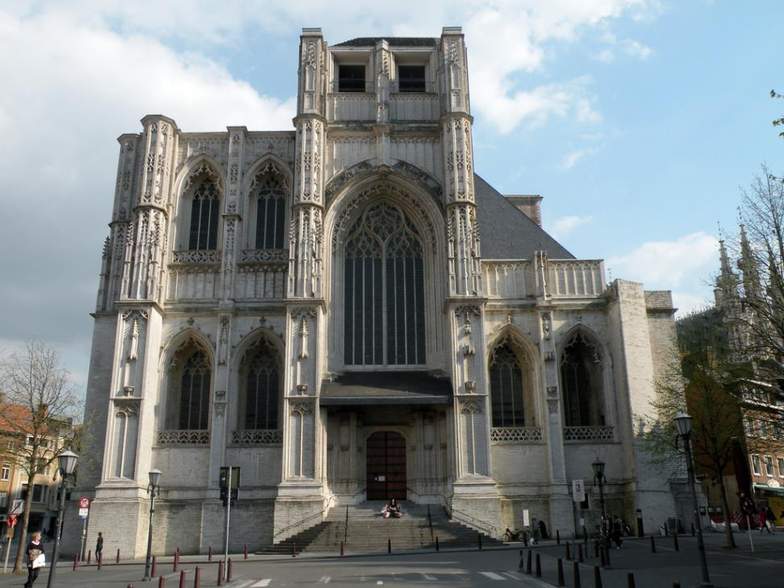
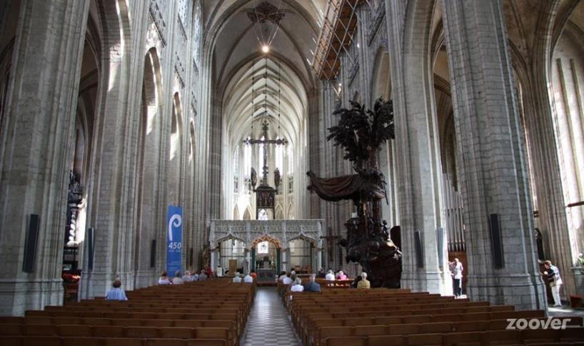
Saint Peter's Church
Grote Markt
Build in 15th century
Gothic style
Unfinished tower

Slide 24
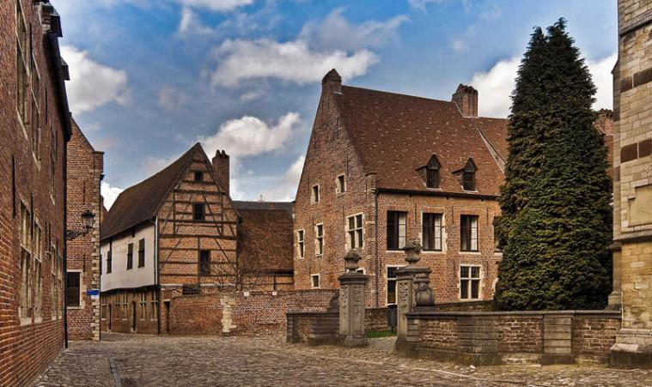
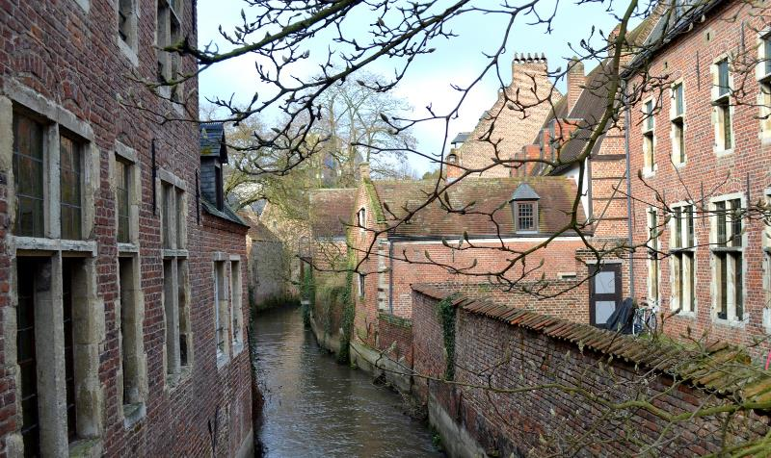
Great Beguinage
Past
13th – 17th century
About 360 beguines
Now
Listed as Unesco World Heritage
Owned by the University

Slide 25
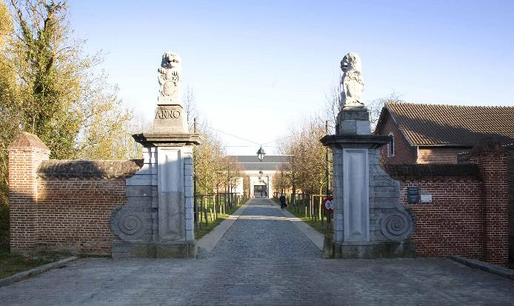
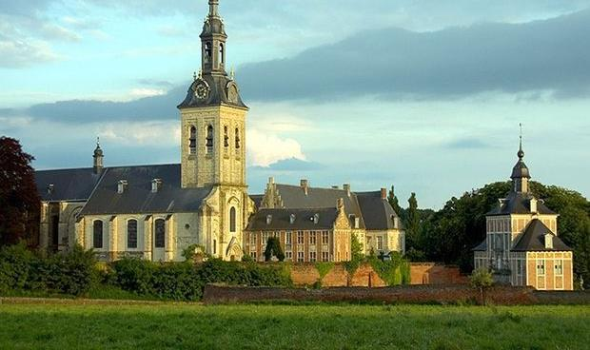
Park Abbey
A Norbertine abbey
In Heverlee, next to Leuven
Best preserved abbey in Belgium
New museum

Slide 26
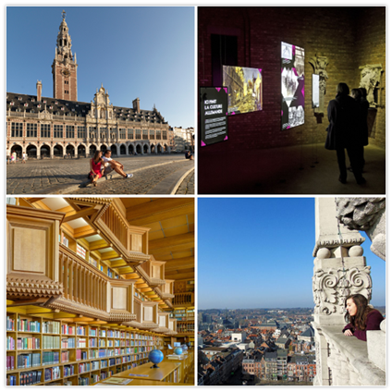
University library & tower
1636: established
1914: burned down by Germans
WWII: new fire
1951: rebuilt

Slide 27
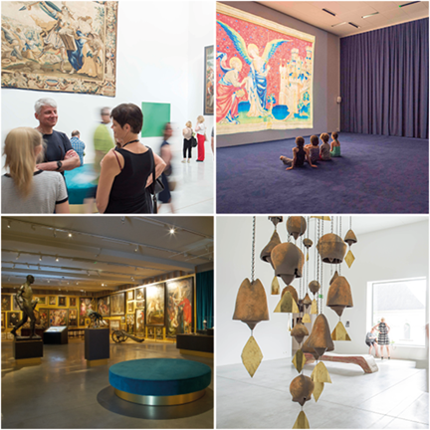
M-Museum Leuven
Opened in 2009
Architect Stephane Beel
Exhibitions
Old art
New art

Slide 28
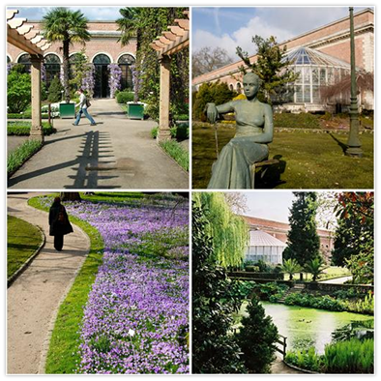
Botanical Garden
Catholic University of Leuven
Students of medicine in 1738
Oldest one in Belgium

Slide 29
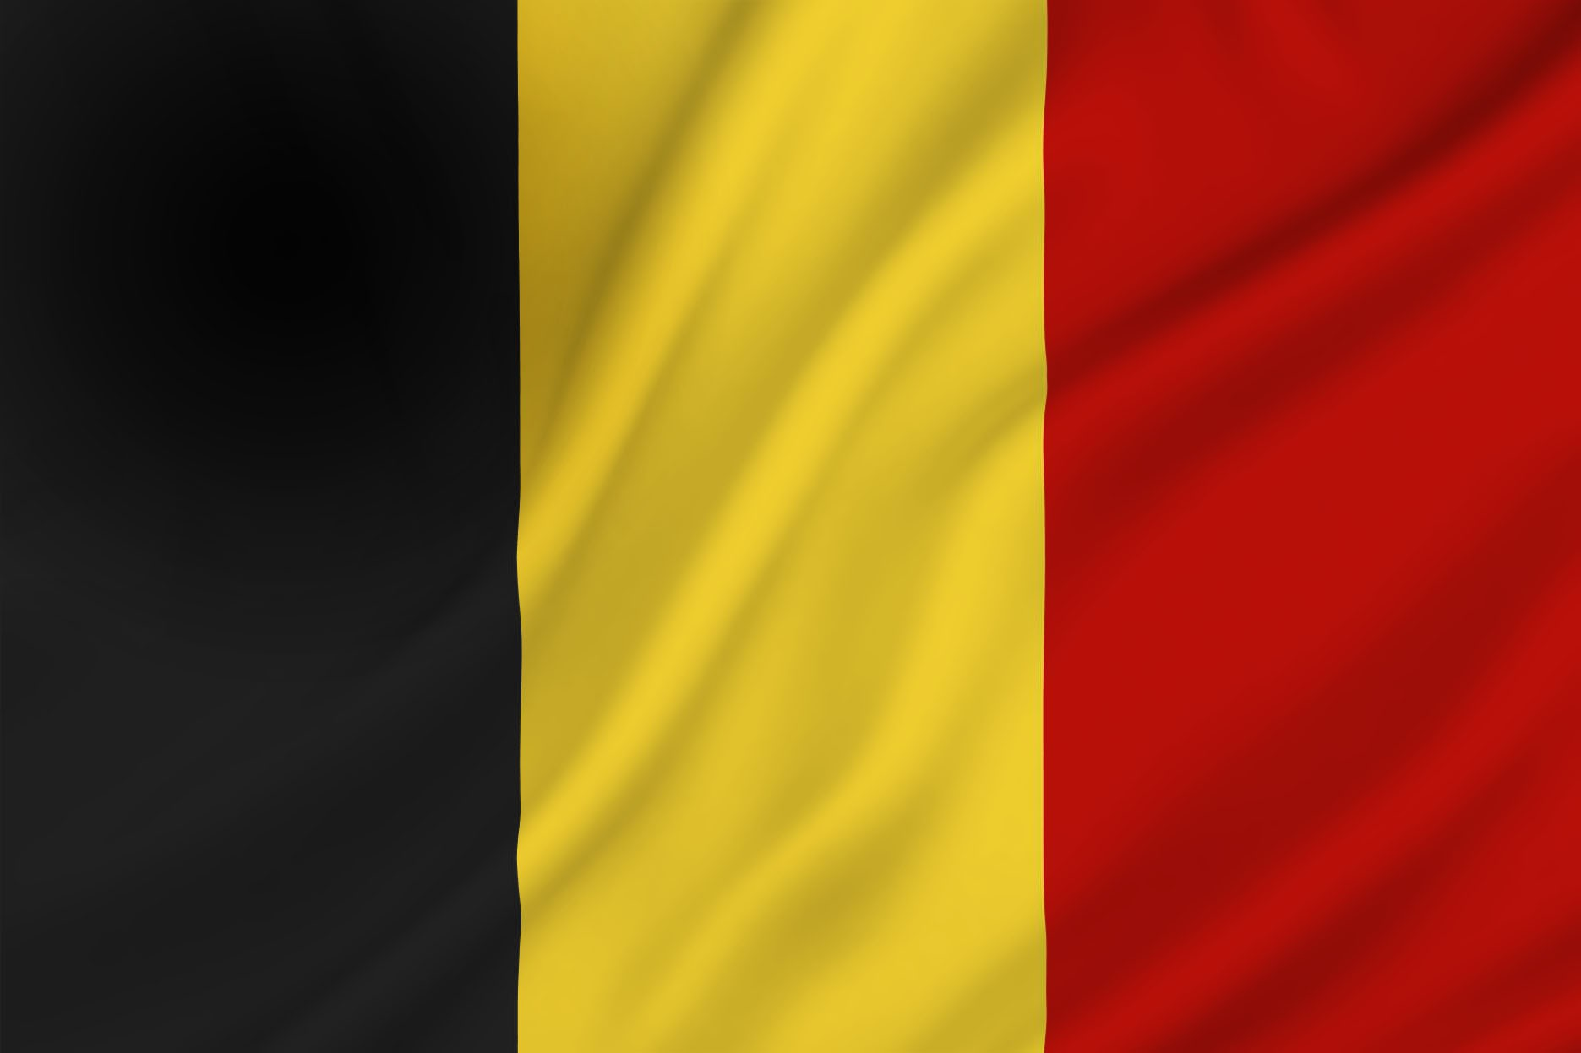
Come visit us!!
Thank you

