Slide 2
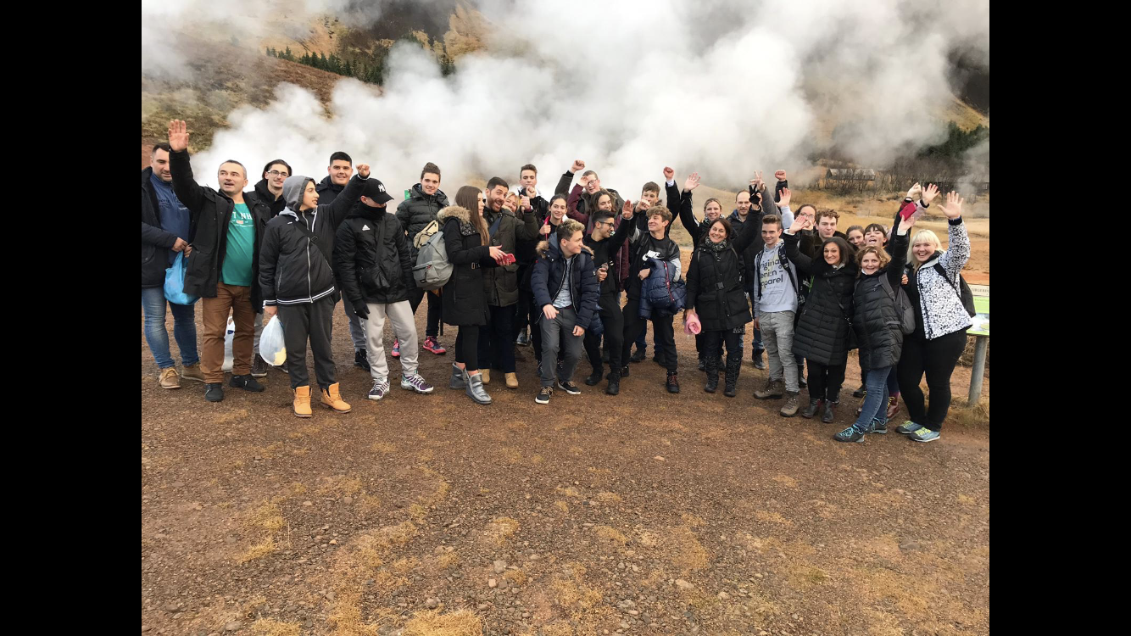
Review
ICELAND November 2018

Slide 3
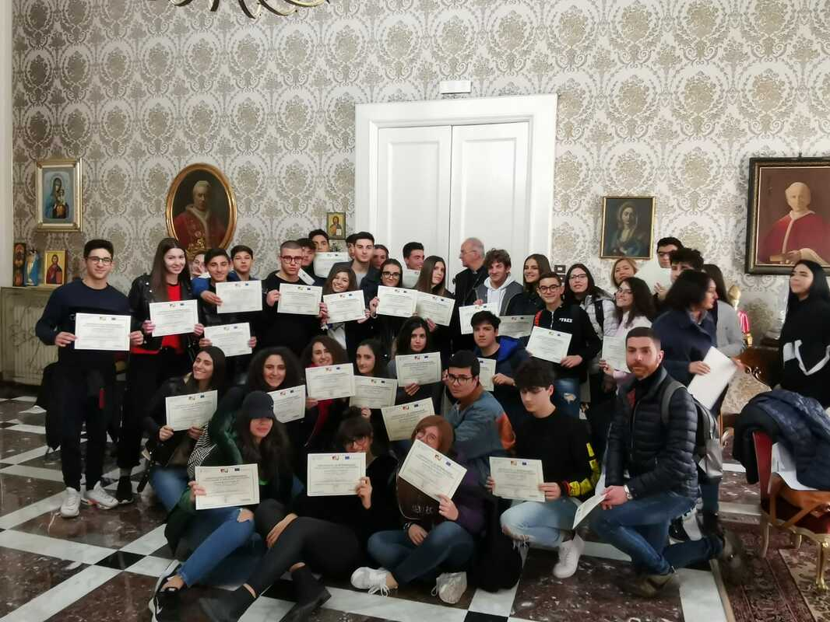
Review
ITALY APRIL 2019

Slide 4
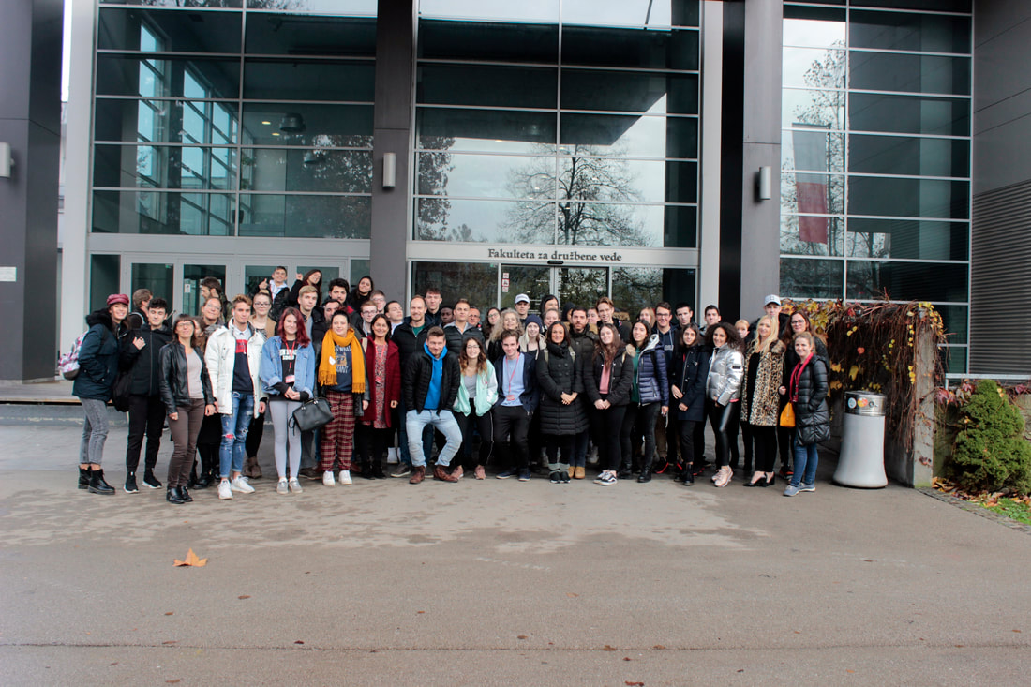
Review
SLOVENIA NOV 2019

Slide 5
Review
GERMANY March 2020
CANCELLED

Slide 6
Review
GREECE September 2020
CANCELLED

Slide 7
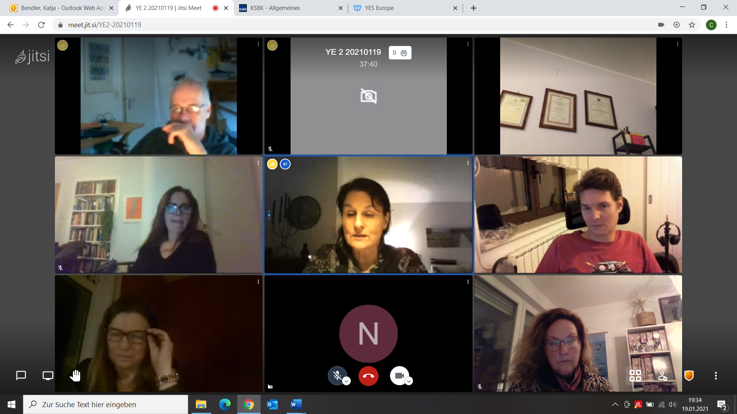
Review
Teachers Video Conference…
CANCELLED

Slide 8
Review
Virtual Activity, 9th February 2021
Welcome and short introduction
Presentation of Slovenia (Primoz Bric, students Slovenia)
Student activity: Working in Groups – 25 students (5 per country, 5 groups)
Short presentation by students
Virtual photo shooting
Bye Bye Yes Europe II

Slide 9
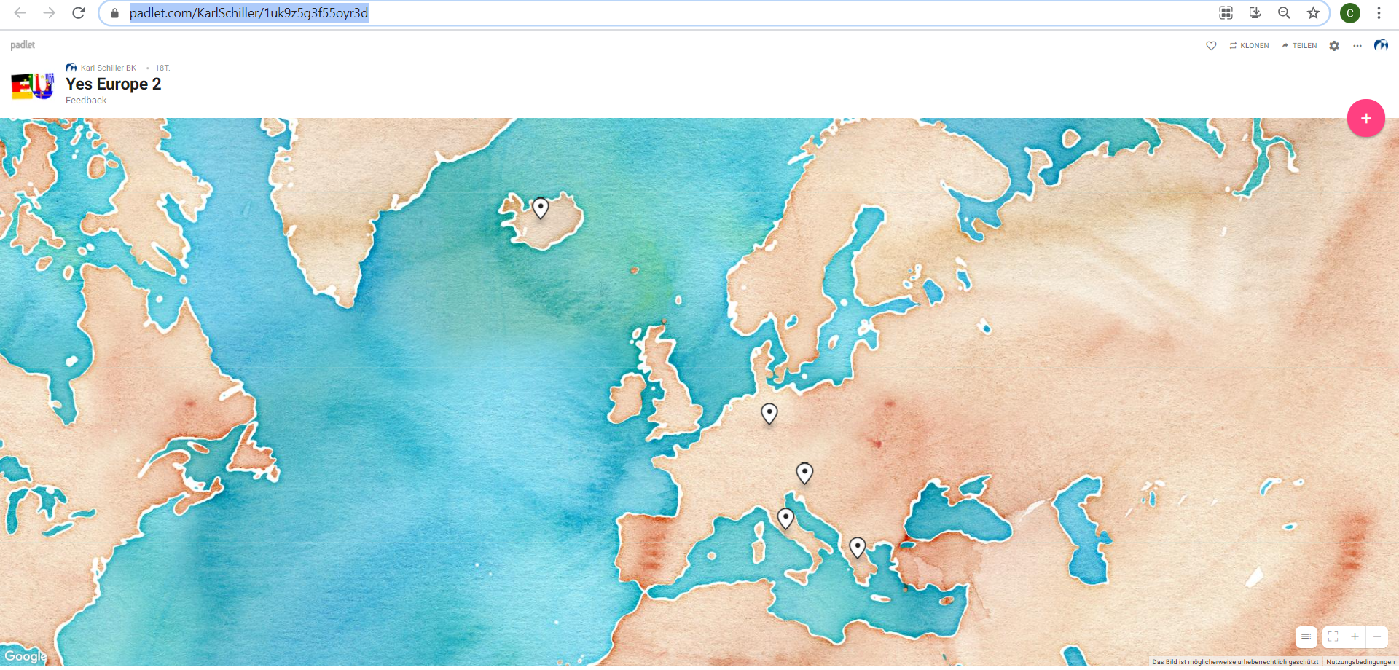
Virtual Activity, 9th February 2021
Virtual Activity, 9th February 2021
https://padlet.com/KarlSchiller/1uk9z5g3f55oyr3d

