Slide 1
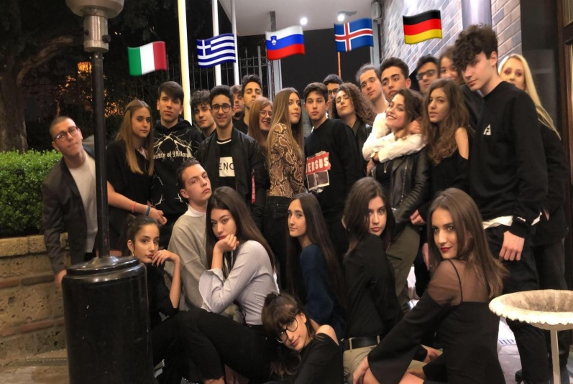
FINDING A JOB IN ITALY
STUDYING IN ITALY
Students have noticed some differences between studying in their country and in Italy. Firstly, our school here is bigger but the sport activities aren’t organised as well as in Germany. In addition, there are no long breaks during the morning and in between the classes. There is no school cafeteria where students can have a coffee or eat something. Moreover foreign students found out, that our grades are from 1-10 and that we don’t change classrooms but instead the teachers do.
FINDING JOBS IN ITALY
To find a job in Italy there are several important things to do. At first, you can take a look at the newspapers but you can also apply to working agencies. Furthermore you can surf the internet searching for job announcements. To find a job you need many qualifications.
SKILLS AND COMPETENCES
Speak fluent Italian (official language of Italy)
Speaking other languages to guarantee a better performance at work
Having a qualification of a certain degree depending on the job you are applying for
Having previous work experience
Having managing and leading skills
Being adaptable
DIFFICULTIES
Working in Italy might be really difficult because of the unemployement crisis. It required to have an advanced education, which not everyone can acquire easily. Also burocracy slows down the employement process.
WHAT DID YOU ENJOY MOST DURING THIS WEEK?
After we arrived in Italy, we were welcomed by the students with the typical Italian hospitality and an open mind. We had the possibility to enjoy the experience of a new culture, traditions and the life in Aversa, a foreign city for all of us. We all enjoyed the Italian cuisine a lot, especially with the capital of Pizza, Naples, so close to Aversa. We were happy to be hosted by Italian families, which gave us the feeling of being part of their community. Our highlights of the week were the many trips to different towns and the historic sites of the area.

