Slide 1
How to study in belgium?

Slide 2
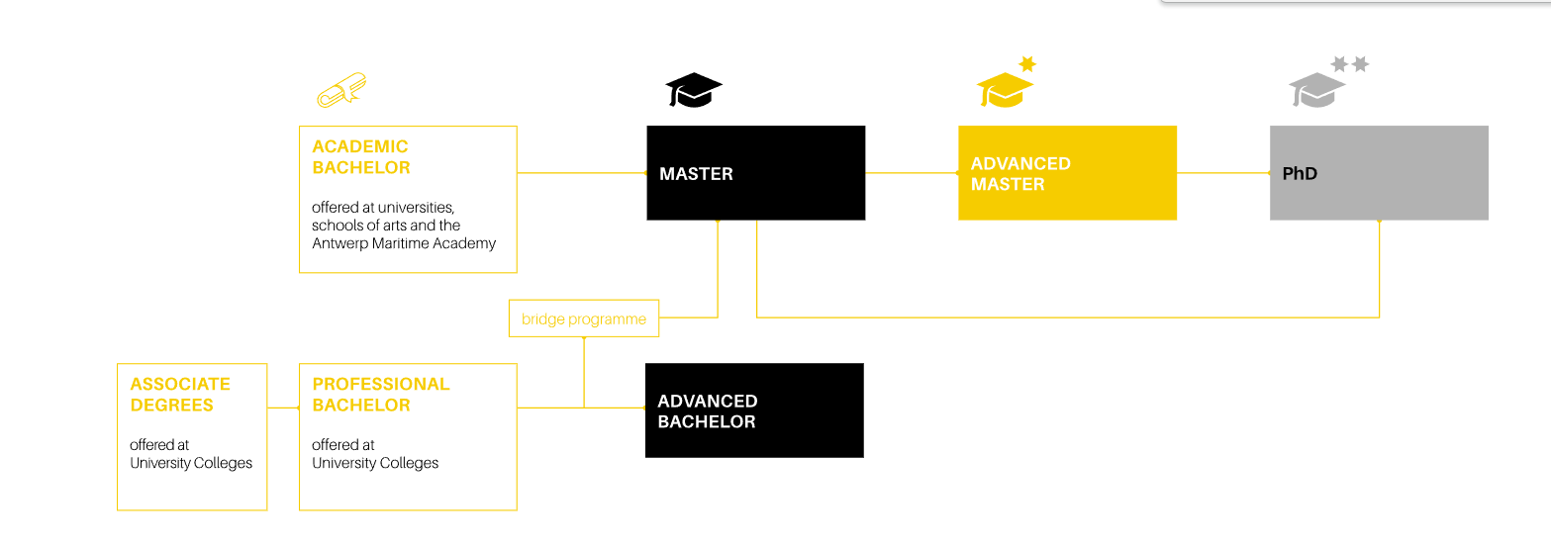
University system in Belgium
The Flemish higher education system is a binary system, consisting of 18 publicly funded higher education institutions: five universities and 13 small and medium sized university colleges, known as universities of applied sciences and arts.

Slide 3
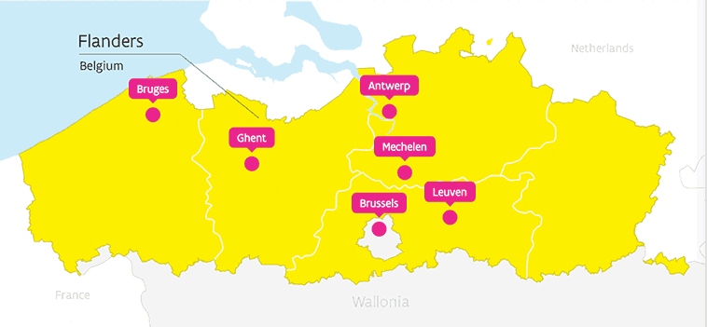
Steps for applying in Flanders
First step: online application
Second step: follows up
Third step: find a place to stay
Fourth step: registration

Slide 4
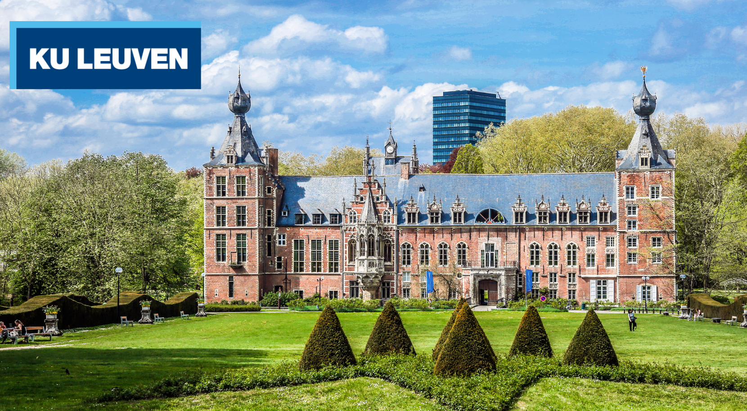
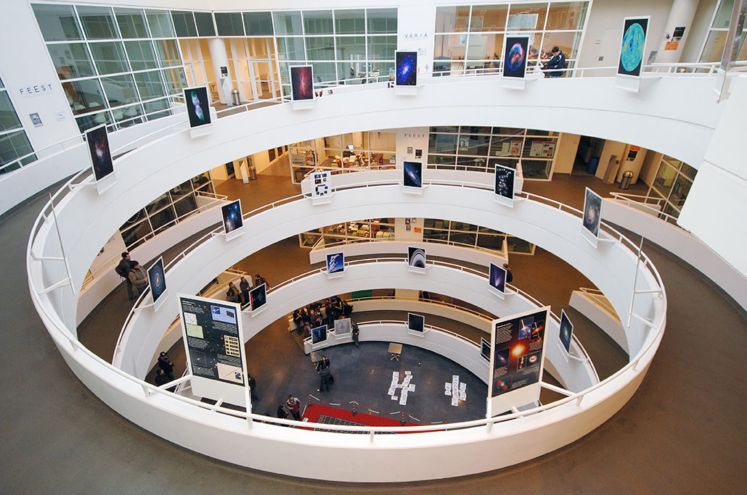
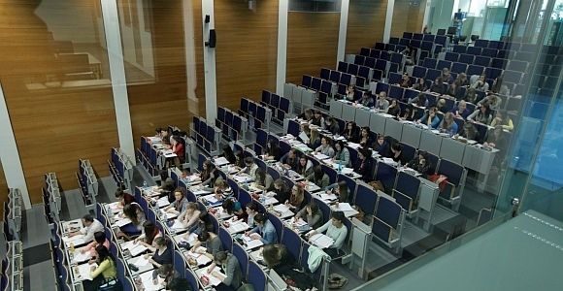
KU Leuven
The University that is now known as KU Leuven was founded by Pope Martin V on 9 December 1425.
KU Leuven is one of the oldest university in Europe, it will be its 600th anniversary in 2025.
KU Leuven accommodates 50,000 students, spread across the various campuses in Leuven and elsewhere in Flanders.
The University and University Hospitals Leuven each employ almost 10,000 people.
Students that study in KU Leuven can study for free in Agora.

Slide 5
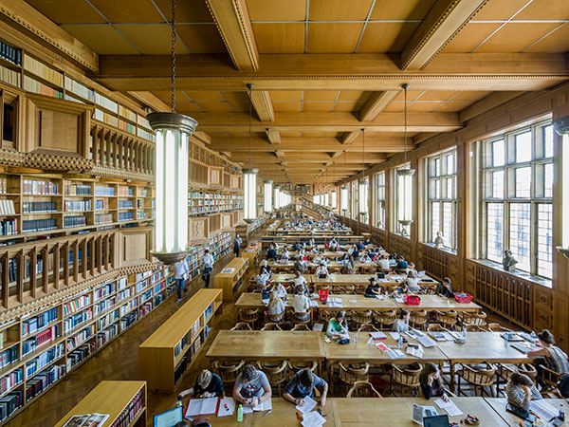
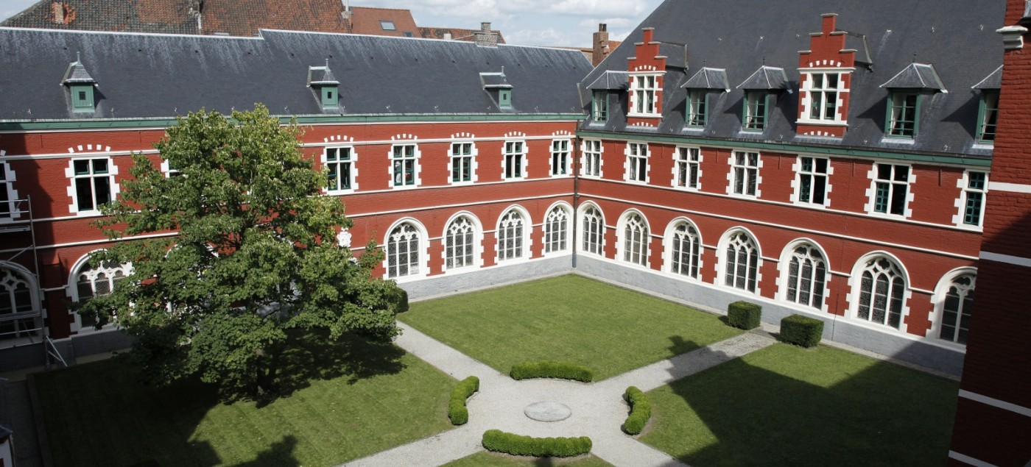
How to apply in KU Leuven
When to apply? - depends on the type of program you are applying to and your country you are from.
The instructions for applications are different for the different programs you want to apply to.
If you have problems applying the Admission office can help you.
You have to have a diploma from High School to get in the University.

Slide 6
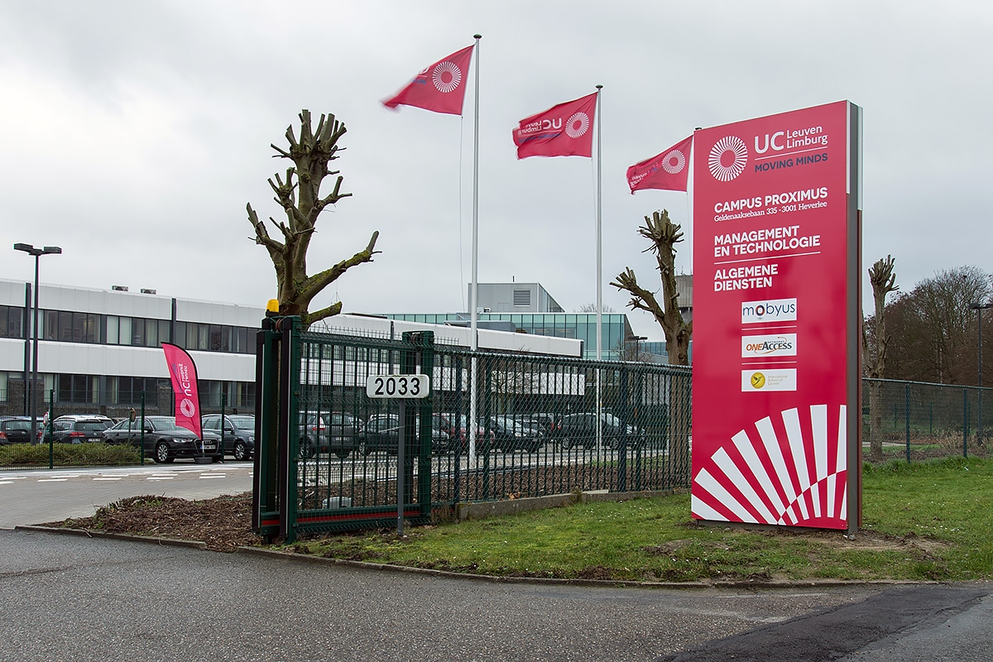
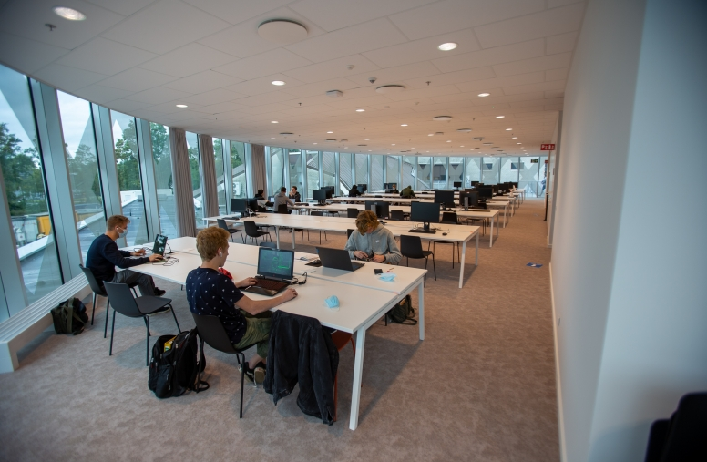
UCLL
UC Leuven-Limburg (UCLL) is one of the major universities of applied sciences in Flanders.
UCLL was founded in 2014, it’s a new university.
The University has over14,000 students and 9 campuses.

Slide 7
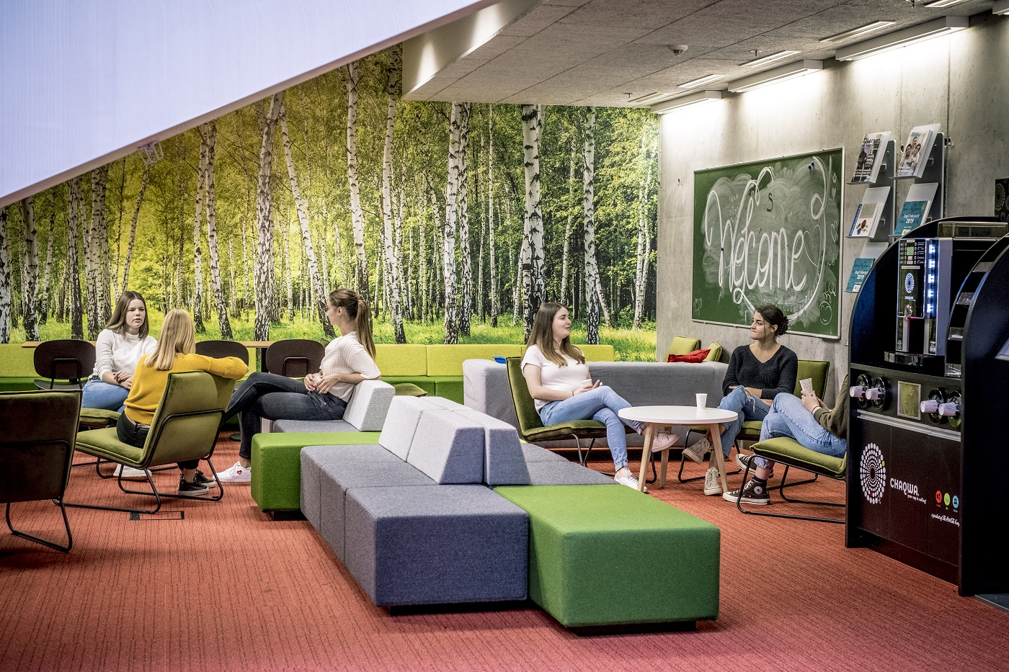
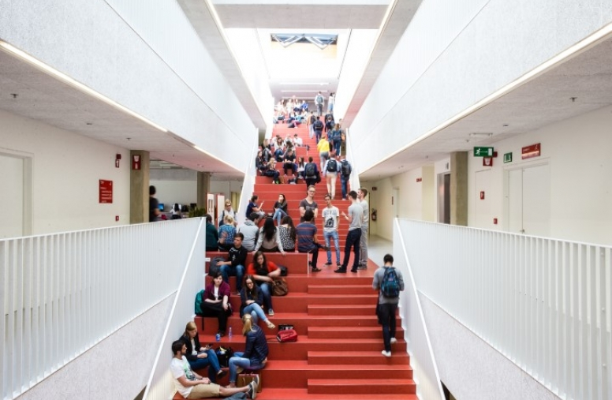
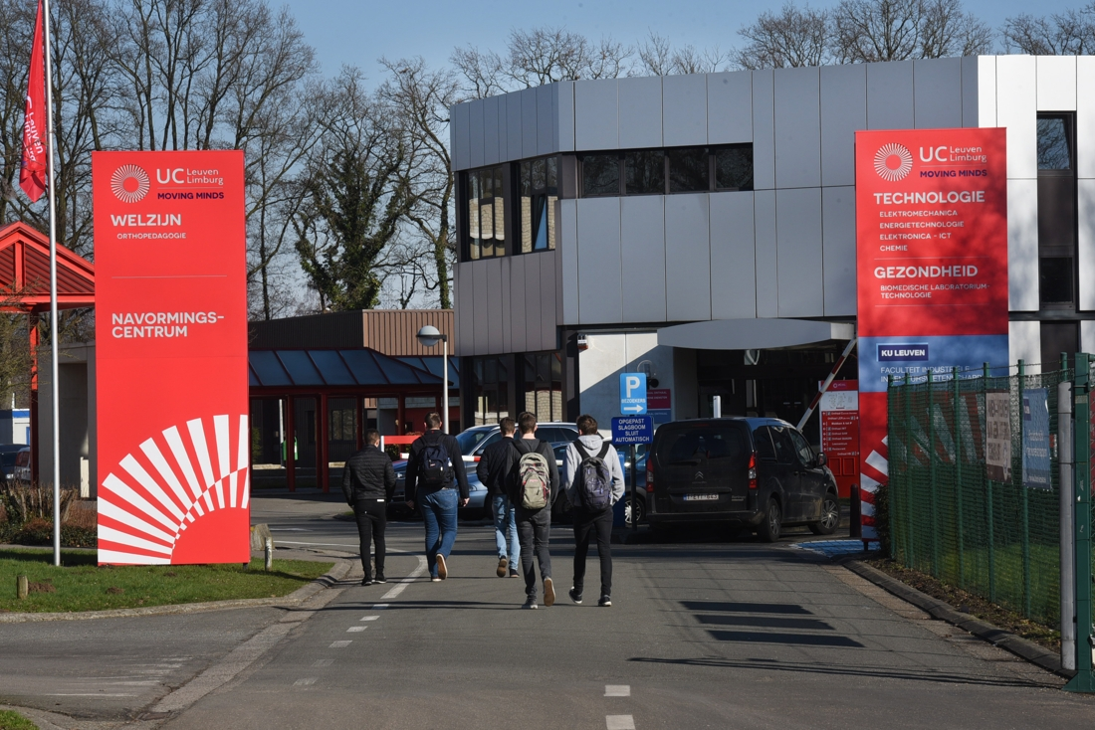
How to apply at UCLL
First you need to send an online application and you have to wait for aprovement.
After the Aprovment you have to choose what and for how long your going to study.
You have to make an account on the site – you need a picture and high school diploma, after that you receive a card for the Campus.

Slide 8
Thank you for the Attention!
Neda, Naum, Maurice, Eva, Eva, Katja, Jenny and Joey

