Slide 1
EDUCATION SYSTEM IN CROATIA

Slide 2
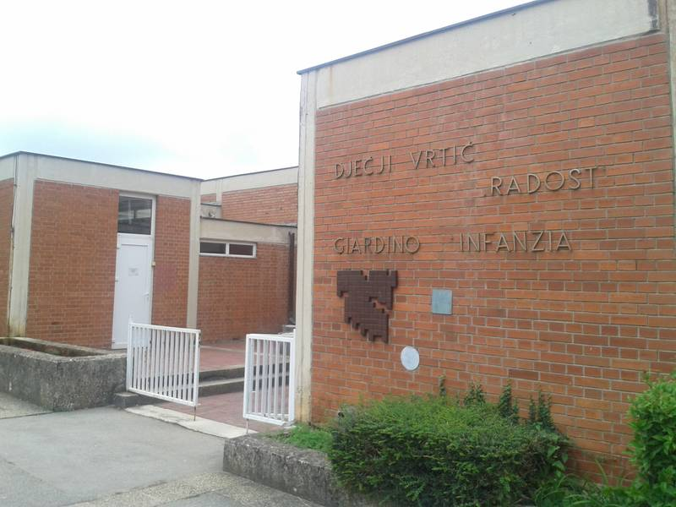
The education system today begins with preschools that include kindergartens and institutions in implementing the pre-school programs and shorter programs
Kindergartens are responsible for a full day or shorter program of education , health care, nutrition and social welfare of children from the age of 6 months to school age .

Slide 3
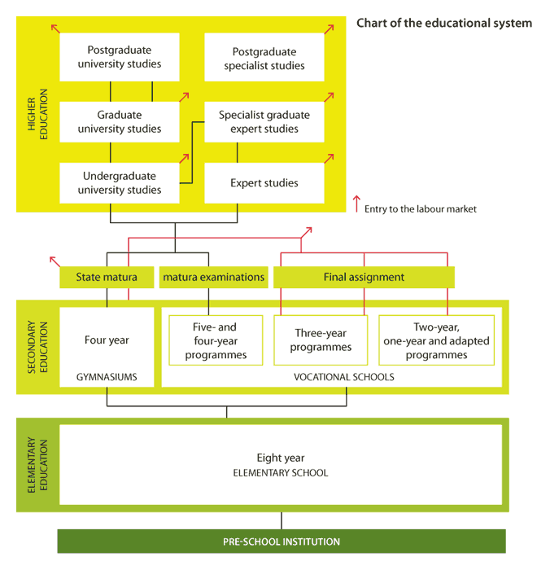

Slide 4
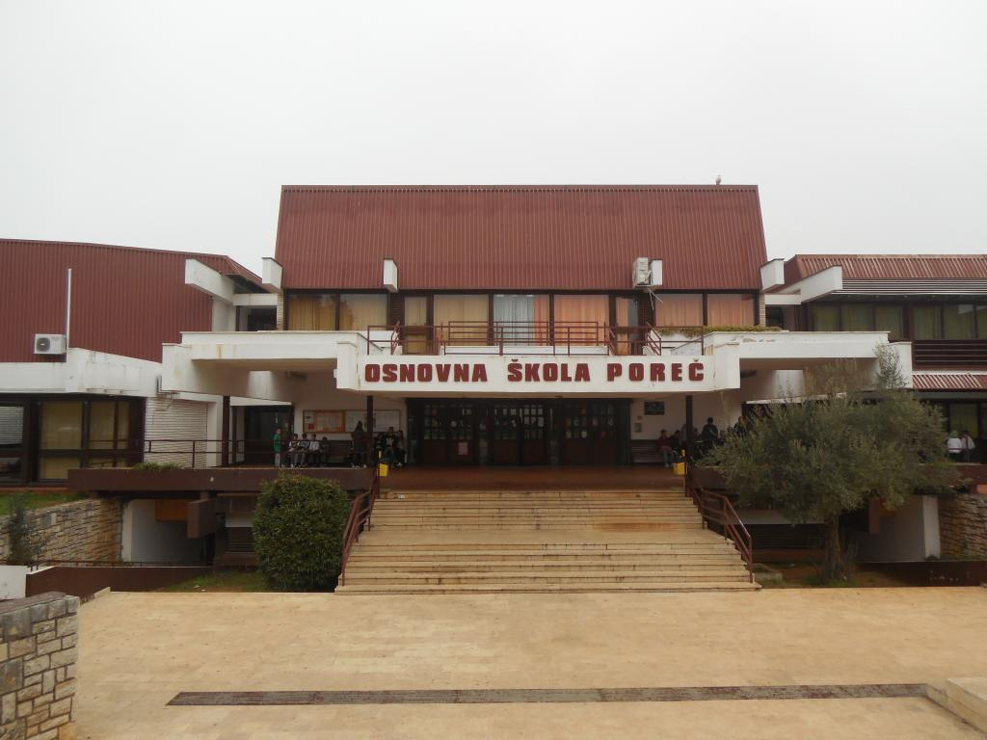
Primary education
Children at the age of 6 or 7 start the compulsory primary education , which lasts eight years . For those older than 15 who have not completed primary school there is a system of basic education for adults .

Slide 5
Secondary schools
After elementary school, children can continue their education in different secondary schools ( secondary education ) , which is based on a curriculum divided into grammar schools and vocational ( technical , industrial, trade ) and arts ( music , dance , art ) school . Gymnasiums with general education curriculum last four years and end with the mandatory final exam- state matura exam.

Slide 6
Vocational and art schools
Training in vocational and art schools can last 1-5 years, and it usually ends with the defense of the final work , but it is possible to take the state graduation for those students who have completed four years of secondary education . The success of the state graduation exam is the basis of enrollment in higher education institutions . Attending primary and secondary public schools is free.

Slide 7
Higher education
Higher education is organised at institutions of higher education through university and professional studies . Higher education institutions are divided into colleges, higher schools, universities and academies of art .

Slide 8
THE END!

