Slide 1
VDAB
MAY 2022
Notes:
One of my main tasks, in a nutshell, is to stay informed about the amount of unemployed jobseekers, the amount of vacancies, and the balance between them in Flanders. In my job I am also interested in how this balance evolves during time and in different sectors.

Slide 2
Flanders
Notes:
As VDAB is situated in Flanders, and as we also know that people abroad are not that familiar with a small region as Flanders in - even a smaller - country as Belgium, we would like to start this presentation with a short video of Flanders and its specialities.

Slide 3
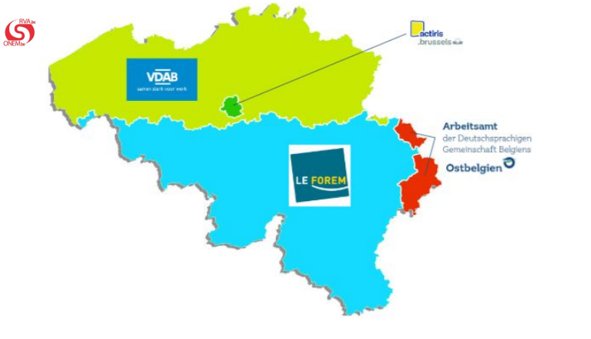
VDAB is the Flemish Public Employment Service
Unemployment
Federal authority
Job seeking
Regional authority
Notes:
VDAB (abbreviation) = the Flemish Service For Employment and Vocational Training
It is the public employment service of Flanders. We help job seekers find a job and employers fill vacancies, by:
hosting a job site and offering useful digital tools
organizing vocational and non-vocational training
counsel job seekers towards a job
We do NOT:
make a decision on when someone is eligible for employment benefits (RVA) or pay them
pay unemployment benefits (disbursement or paying agent) (uitbetalingsinstelling zoals hulpkas of vakbond)
administrative tasks for companies with employees (f.e. wage administration, wage calculation, holiday pay (social secretariat)

Slide 4
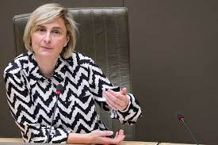
About VDAB
Our mission is to contribute to the creation of a dynamic labour market in a prosperous Flanders that benefits both the individual and society.
We are aiming for an activity rate of 80%.
From leaving school to active retiree: VDAB wants to support all 4 million Flemish citizens during their entire career.
Notes:
In that way we try to contribute to both the health of the individual and the society as a whole, as both will benefit from a dynamic labour market. According to the ministry, to be healthy and to face future challenges, we need to obtain an activity rate of 80%. That means that 80% of the people that have the working age, should be working.

Slide 5
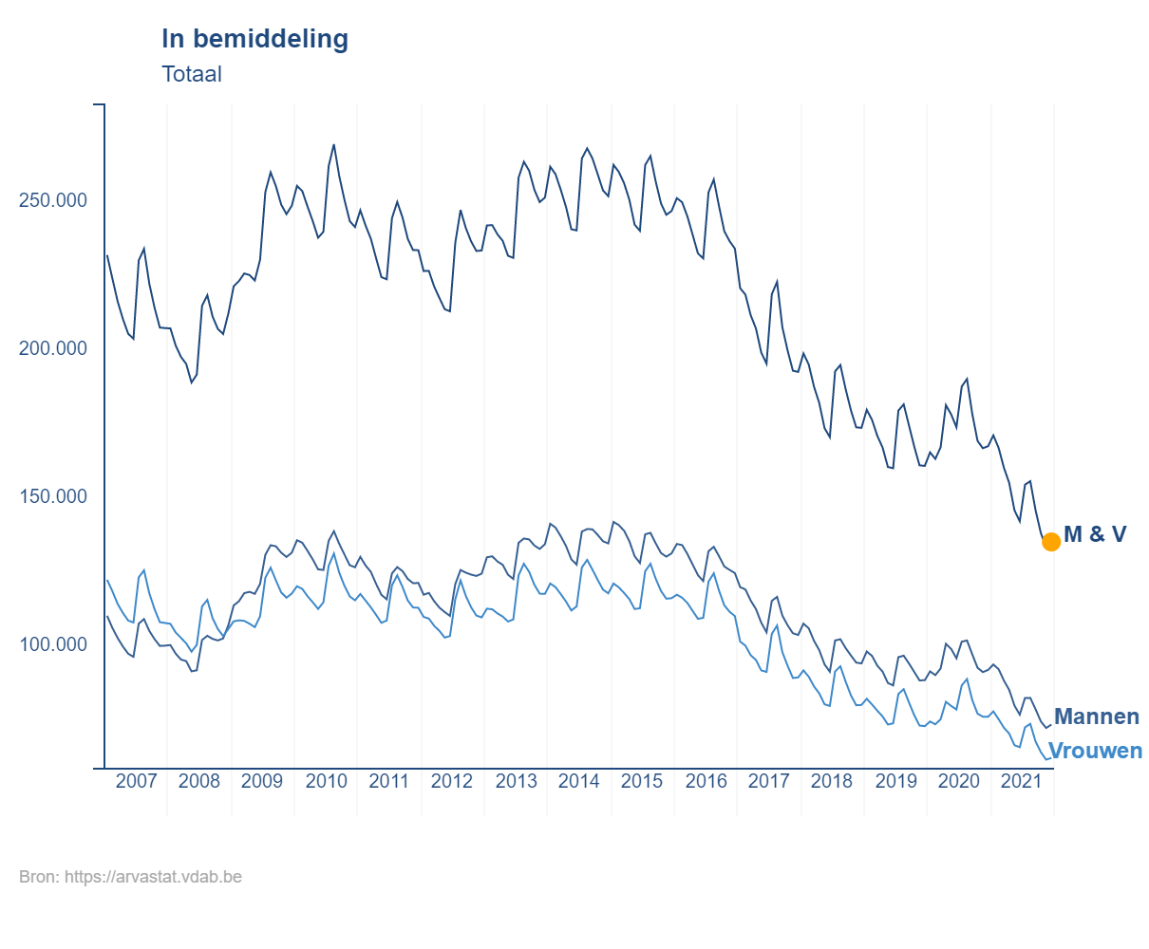
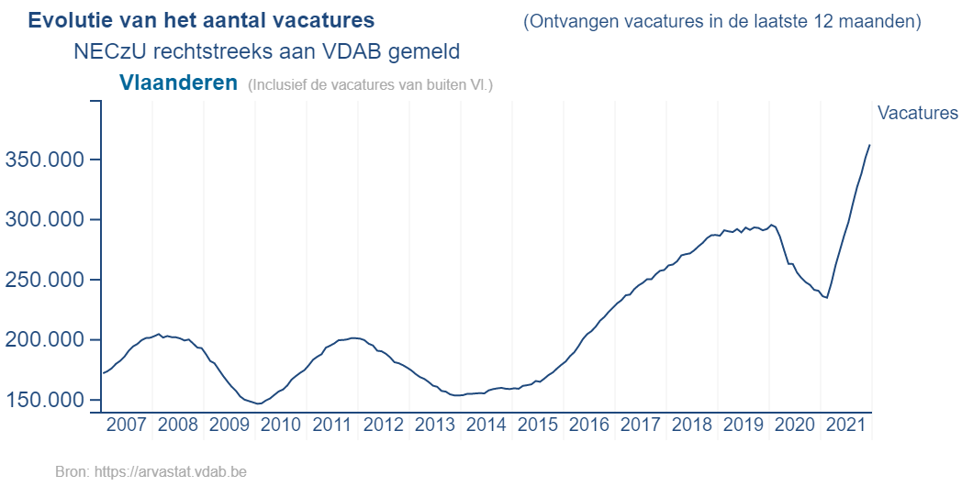
Historical shortages
Unemployed: lowest in 15 years Vacancies: never so high
Source: Arvastat
Notes:
At the moment we are experiencing historical shortages on the flemish Labour Market : on the left you can see that the number of unemployed is at its lowest in 15 years time, whilst the number of vacancies was never so high.

Slide 6
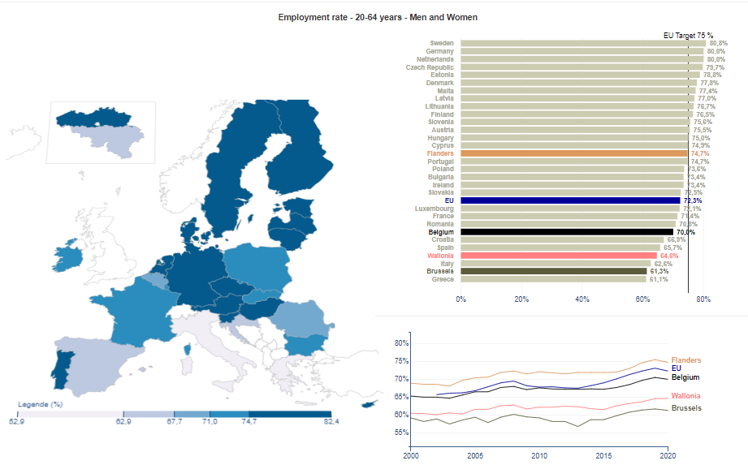
Employment rate in Flanders 74,7%
Above EU average but the Flemish Target is 80% by 2030
Source: https://europa.vdab.be/
Notes:
The employment rate indicates the share of the population at working age (between 20 and 64 years old) that is employed.
The employment rate in Flanders was 74,7% in 2020. This is above EU average but Flanders has set herself a target of 80% by 2030. So we are not quite there yet.
Our neighbouring countries Germany and the Netherlands already achieved 80%.

Slide 7
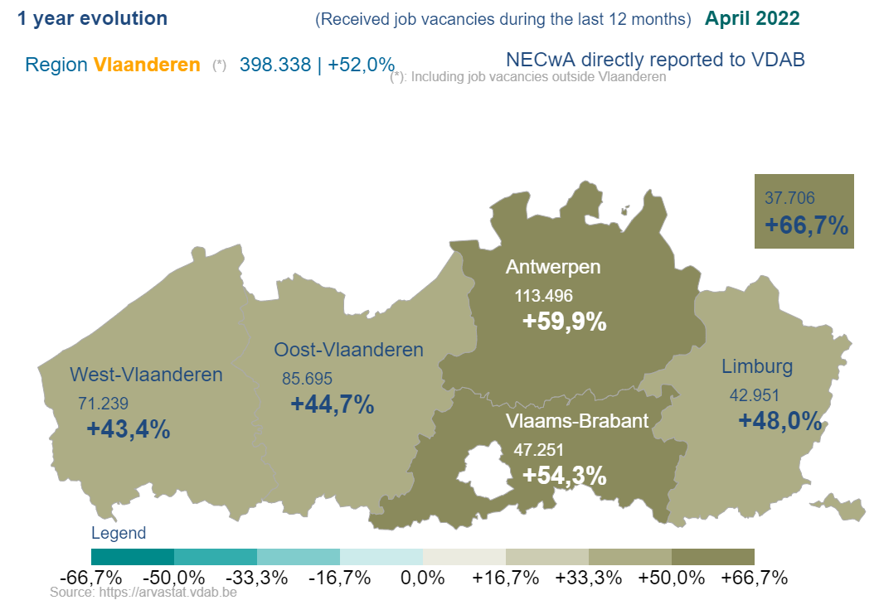
Vacancies
In comparison with last year we see the greatest increase in the provinces of Antwerp and Flemish Brabant.
Source: Arvastat
Notes:
VDAB receives the vacancies through various channels : from the companies themselves and from commercial channels like temp agencies and headhunters.
In the last 12 months VDAB received almost 400.000 vacancies from companies themselves in Flanders. This is an increase of 52% in comparison with last year.
The number of vacancies is even higher now than before the COVID-19 crisis.
The majority of the vacancies received is located in the province of Antwerp (113.496), followed by the province of Flemish Brabant (47.251).
For about 1 out of 3 vacancies, companies ask us for extra support to fulfill them, which means that we help them in any way we can.
Usually these are the most difficult to fulfill, so we have to pull all of our strings.
temporary agency work, headhunters, …he numbers are artificially high because
of doubles

Slide 8
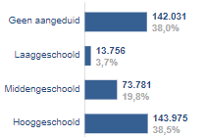
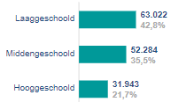
Gap in competences
recruiting = training!
Level of education in vacancies
(Flanders Feb 2021 - Jan 2022 directly received from companies by VDAB )
Level of education of unemployed in mediation
(Flanders average Feb 2021 - Jan 2022)
Unspecified
Lower education
Secondary education
Higher education
Lower education
Secondary education
Higher education
Source : Beroepen in cijfers
Notes:
One of the biggest discrepancies on our labour market is the level of education.
Almost 40% of the vacancies from last year demand a higher education but only 1 out of 5 of the available labour reserve has a higher education.
This means that it is important for employers to know that recruitment often involves training.
VDAB can offer tailormade solutions, like different forms of workplace learning. A good example is the site that you will visit later today.

Slide 9
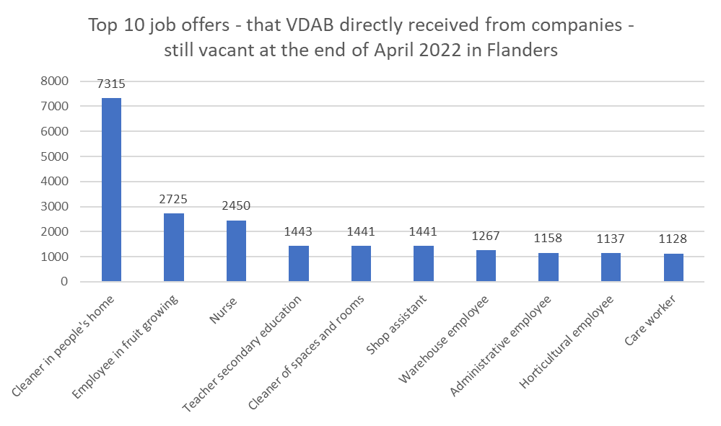
Top 10 Job offers still vacant at the end of April 2022 in Flanders
Source: VDAB, arvastat
Notes:
When we look at the job offers that are still vacant at the end of April of 2022, this is our top 10.
You will see these reflected in the list of bottleneck occupations.

Slide 10
Top 10 bottleneck occupations
2022 Flanders
Health care
Construction
Transportation
Technically skilled workers
IT
Nursing (associate) professionals
Technician industrial installation
Building site manager
Cleaning professionals
Electrical mechanics
Construction calculator
Building Information Management - engineering agency
Heavy truck and lorry drivers
Systems analyst & applications programmers
Accountants
Source: VDAB bottleneck occupation study 2022
Notes:
Each year we publish a research on the bottleneck occupations in Flanders. This is the top 10 for 2022.
The sectors with most difficulties of filling their vacancies for the last couple of years are Health care, Construction, Transportation, Technically skilled workers, IT.

Slide 11
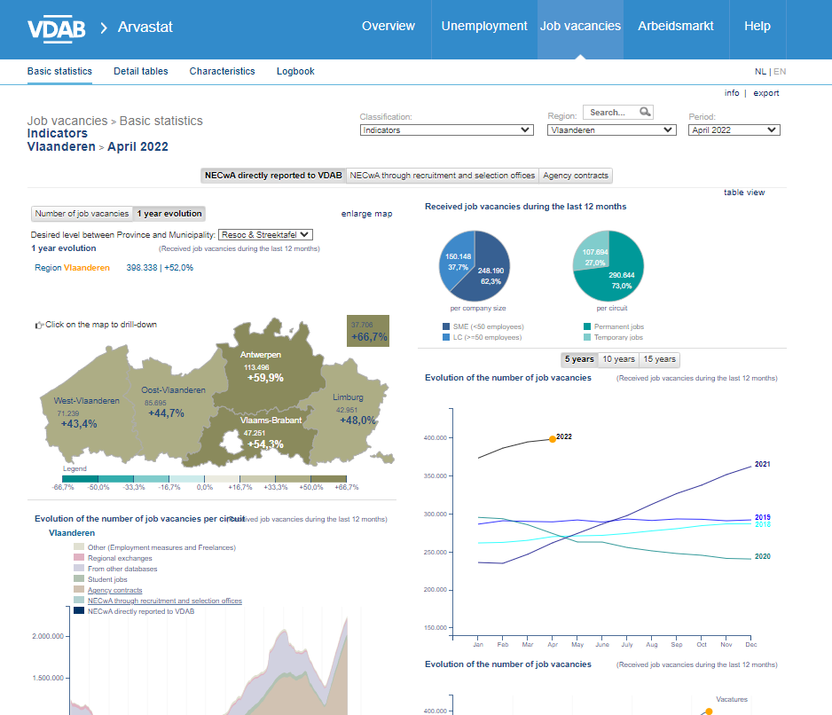
Vacancies and unemployed today
Arvastat.vdab.be: our online tool
Source : Arvastat

Slide 12
Vacancies and unemployed today
Arvastat.vdab.be: our online tool
Exercise - “unemployment in Flanders”
How many unemployed jobseekers do we currently count in Flanders?
How many (%) are 2 years or more unemployed?
What is the amount of low-skilled unemployed jobseekers?
Exercise - “truck driver distribution”
How many vacancies did we receive in Flemish Brabant, in the last 12 months?
How many vacancies are currently (April 2022) open?
In how many of these open vacancies are they looking for candidates with experience?
Source : Arvastat

Slide 13
Vacancies and unemployed today
Arvastat.vdab.be: our online tool
Exercise - “unemployment in Flanders”
How many unemployed jobseekers do we currently (April 2022) count in Flanders? 175.933
How many (%) are 2 years or more unemployed? 38.9%
What is the amount (%) of low-skilled unemployed jobseekers? 44.5%
Exercise - “truck driver distribution”
How many vacancies did we receive in Flemish Brabant, in the last 12 months? 247
How many vacancies are currently (April 2022) open? 82
In how many of these open vacancies are they looking for candidates with experience? 47.6% (39)
Source : Arvastat

Slide 14
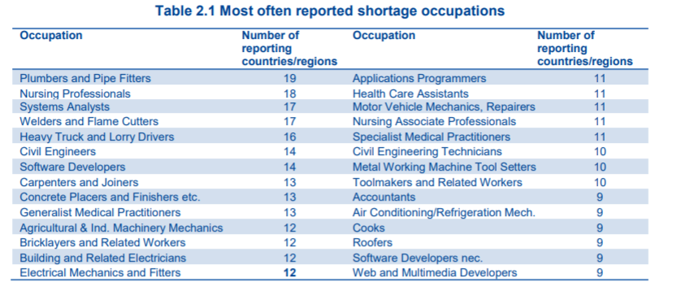
Most often reported shortages - bottleneck occupations in Europe
Finding mutual opportunities? international@vdab.be
Source: European Labour authority, 2022
Notes:
It’s important to know that most European countries experience similar shortages, therefore VDAB has a specialised division to work together and find mutual opportunities.
The international team of VDAB consists of 6 advisors and one coordinator. They operate in a European cooperation network of employment services, called EURES, designed to facilitate the free movement of workers, without creating a brain drain in other countries. But because of the similar shortages, the international advisors are also prospecting recruitment possibilities outside of Europe.
They are very happy to give you more in depth information about their service. Don’t hesitate to contact them on international@vdab.be.

Slide 15
International mobility

Slide 16
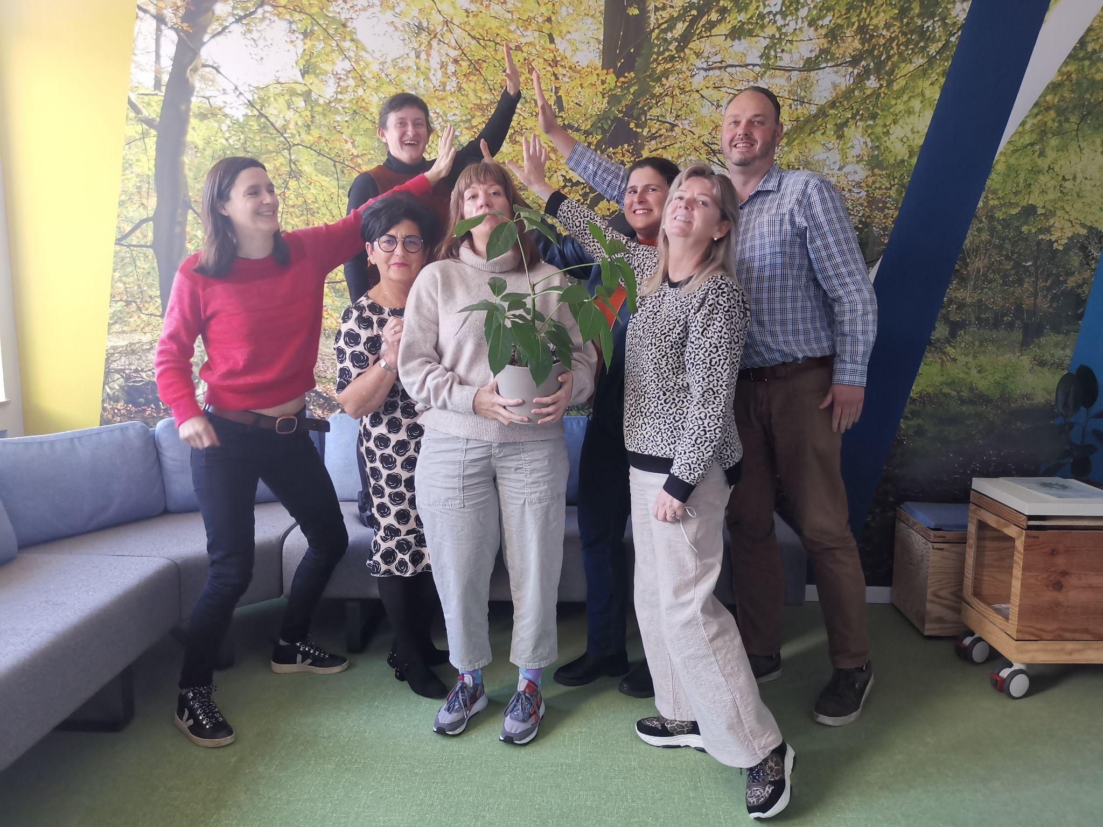
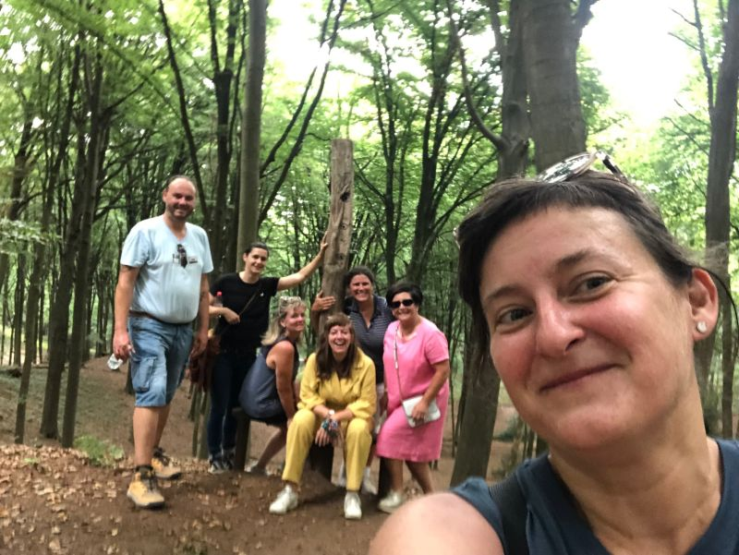
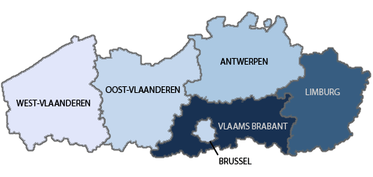
Team of 6 mediators + 1 teamleader
Annelies Thomas
O + W VL
Grensregio NL
Industrie en DAPB
Kyra Veldkamp
Antwerpen
Industrie en IT
Carine Van de Keere
Antwerpen
Grensregio NL
Bouw en DAPB
Roland Brouns
Limburg + VL Brabant
Grensregio NL + DU
IT en Industry
Michèle Op ‘t Eijnde
Limburg
Grensregio NL + DU
DAPB en Bouw
Ellen Albrechts
Teamleader
Jill Delombaerde
O + W VL
Grensregio Frankrijk
Bouw en IT

Slide 17
International service from VDAB
Based on bottleneck vacancies
Incoming mobility needed to keep our strong economical position (and have the possibility to grow)
Strongly related to the VDAB clusters and business plans
Expending profiles and regions

Slide 18
Tools and online information
EURES platform
Website
Information, jobs, CV, tips&tricks
Automatically sharing of vacancies
Work in Flanders
Website
Vacancies database
Information on living and working conditions
European online jobdays
Online tool for organisation of (job) events
Supported by European commission and ELA
Matching, statistics, visualisation,...

Slide 19
EURES

Slide 20
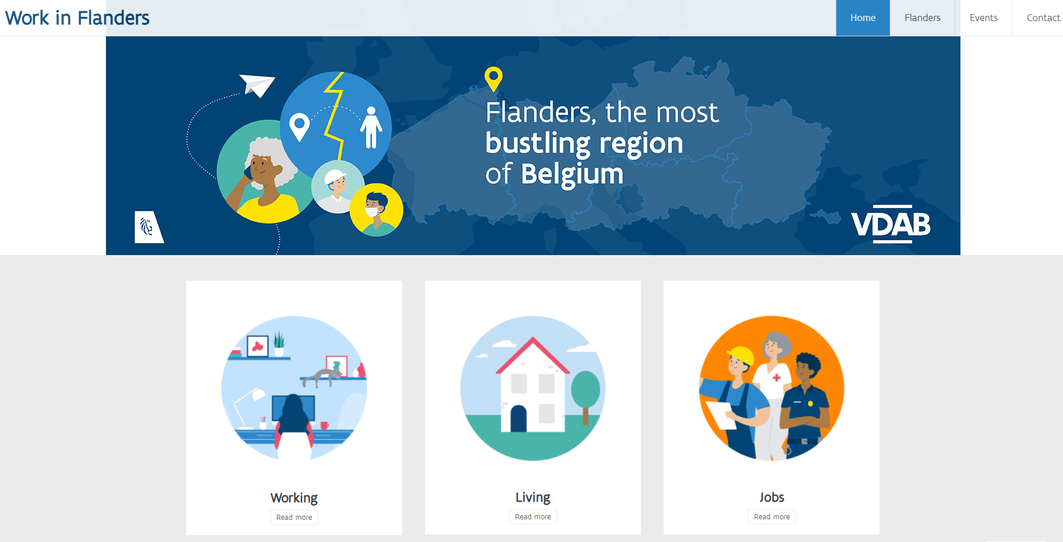
Work in Flanders

Slide 21
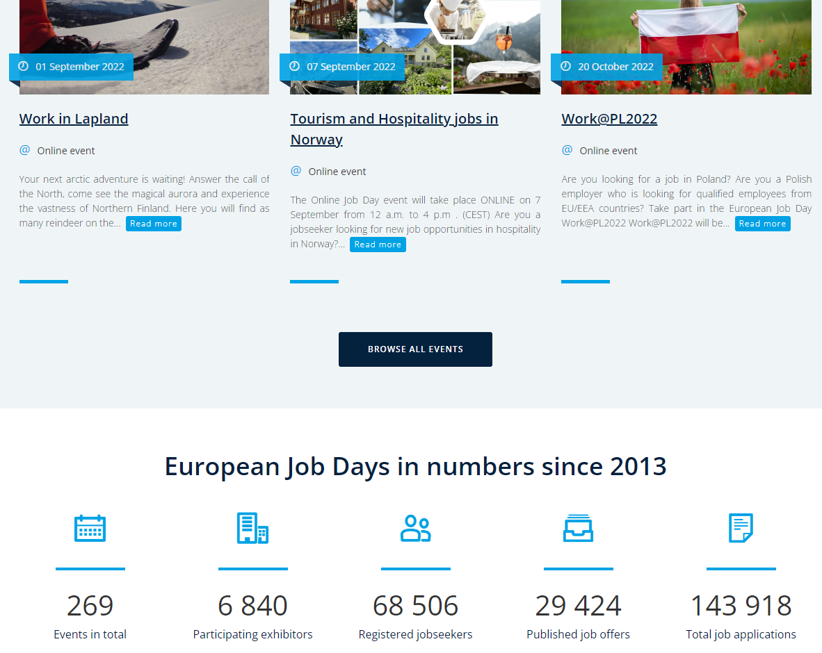
EOJD
European online jobdays

